Slide 1
Regional Analgesia in Painless Childbirth
Dariush Abtahi, MD
Associate Professor, Clinical Research and Development Unit, Imam Hossein Hospital, Department of Anesthesiology, Shahid Beheshti University of Medical Sciences, Tehran, Iran
E-mail: drdariushabtahi@yahoo.com

Slide 2

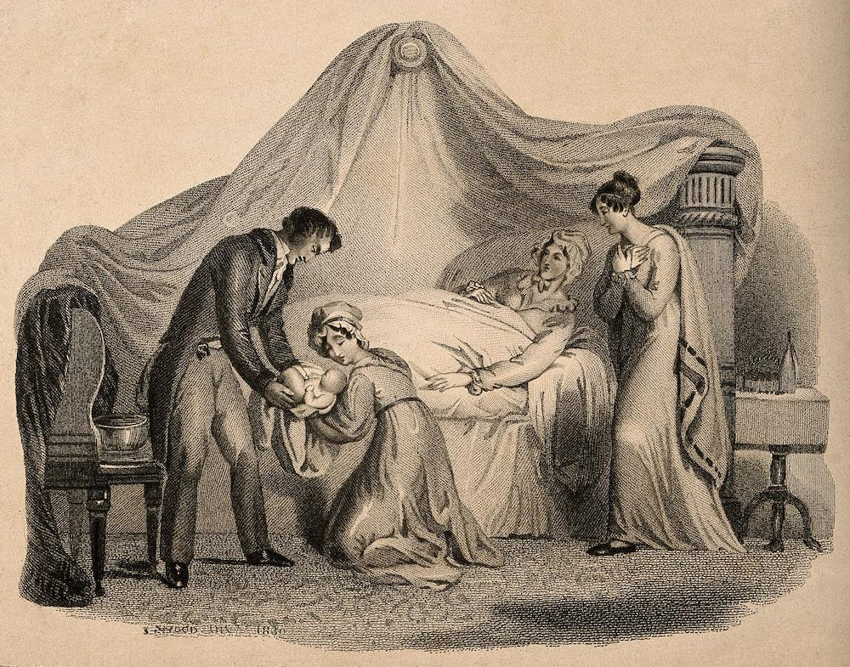
In 1853, … , Queen Victoria received chloroform in labour administered by John Snow, …
she experienced “great relief” and that contractions became “trifling,”… he then publicised in medical circles.

Slide 3


Background
Labor analgesia is increasingly used worldwide:
  5–10% in low‑income settings to > 70% in high‑income countries
Neuraxial analgesia is the most effective method
WHO recommends epidural analgesia as the gold standard

Slide 4

Background
Goals:
  Reduce labor pain
  Improve maternal experience
  Optimize maternal–fetal outcomes

Slide 5
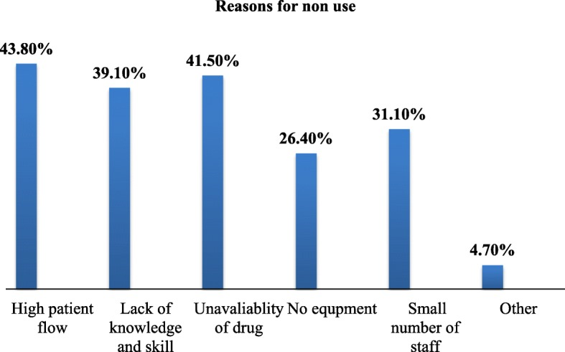

Slide 6
Anesth Pain Med. 2023 Oct 8;13(5):e139079. doi: 10.5812/aapm-139079
Variables | No. (%)
Pregnant women’s information sources
Friends and relatives | 123 (30.4)
Physicians | 26 (6.4)
Nurses – midwives | 27 (6.7)
Radio and television | 41 (10.1)
Internet | 170 (42)
Others | 18 (4.4)

Slide 7
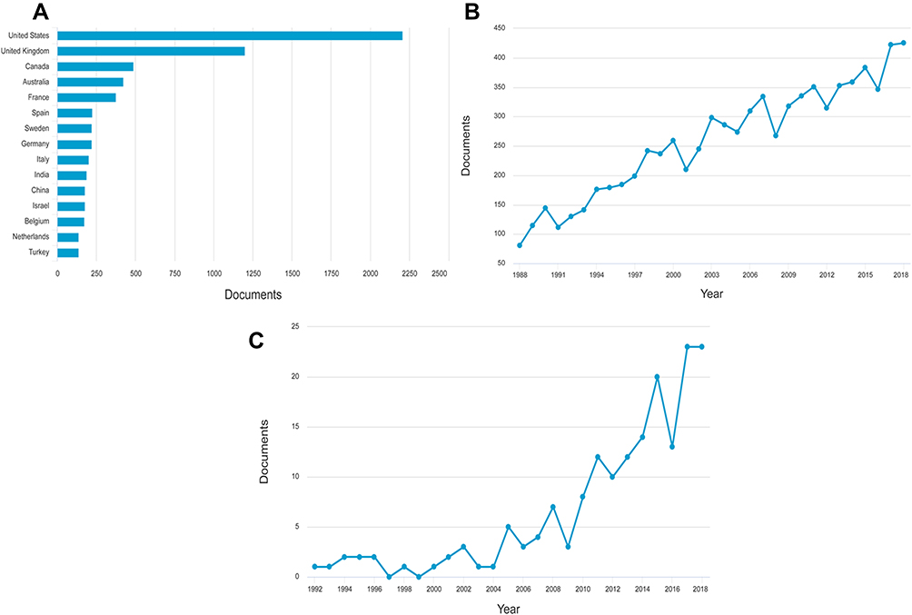




Labor analgesia-related articles in the world and in China
The number of labor analgesia-related publications from the top 15 Countries/Regions.
The global number of publications each year.
The number of publications in each year from China

Slide 8
Analgesia Options & Holistic Care
Neuraxial
Non‑neuraxial
  N₂O, systemic opioids
  Non‑pharmacological (TENS, acupuncture, breathing)
WHO Respectful Maternity Care (RMC):
  Dignity, privacy
  Continuous support

Slide 9

Mirzania M, Shakibazadeh E, Maleki A, Noorafrooz M, Karimi N, Mayra K, Dashtkoohi M, Hantoushzadeh S. Prevalence of mistreatment and disrespect of women during childbirth in the world: a systematic review and meta-analysis. Reprod Health. 2025 Oct 14;22(1):193. doi: 10.1186/s12978-025-02119-6. PMID: 41088180; PMCID: PMC12522719.
This study found that more than half (54.5%) of women globally experience mistreatment and disrespect during childbirth- a widespread and alarming issue.
Our review shows that the prevalence of mistreatment and disrespect during childbirth ranged from 1.9% in Malawi to 100% in Ethiopia, Nepal, and Iran.

Slide 10
Tajvar M, Alipour S, Atashbahar O, Shakibazadeh E, Saeed AS, Khaledian Z. Promoting respectful maternity care: a quasi-experimental study on the effectiveness of an educational intervention in Iranian hospitals. Reprod Health. 2025 Mar 13;22(1):40. doi: 10.1186/s12978-025-01969-4. PMID: 40082893; PMCID: PMC11907772.
Descriptive comparison of general misbehavior scores before and after the intervention
 | Before the intervention (time 1) | After the intervention (time 2)
Number of available data | 357 | 383
Mean | 11.40 | 9.65
Mode | 11.00 | 2.00
Standard deviation | 3.03 | 10.40
Range | 18.00 | 33.00
Minimum | 4.00 | 1.00
Maximum | 22.00 | 34.00

Slide 11

Epidural Analgesia

Slide 12

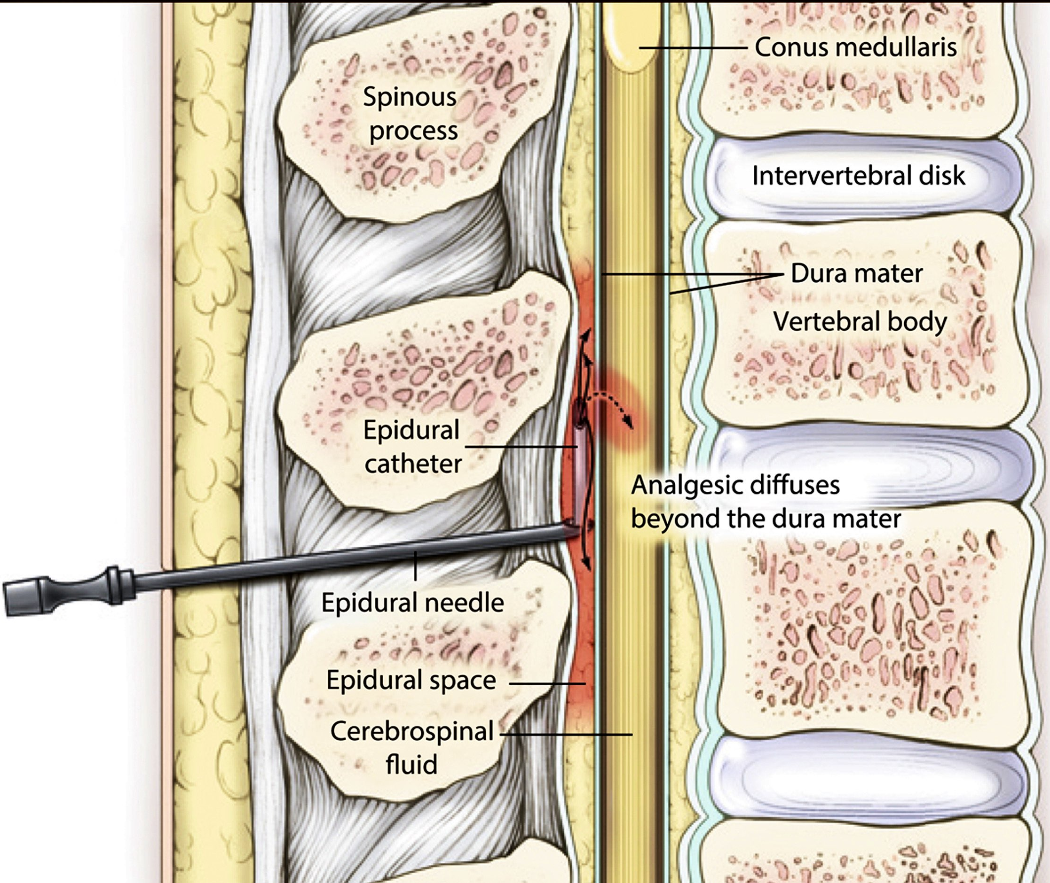
Traditional Labor Epidural Technique
The gold standard!
A needle is placed in the lumbar epidural space through which a catheter is threaded
A combination of local anesthetic+/-opioids are injected
The injectate slowly diffuses to the site of action and stops pain transmission
The catheter is placed on an infusion pump for continuous labor analgesia

Slide 13



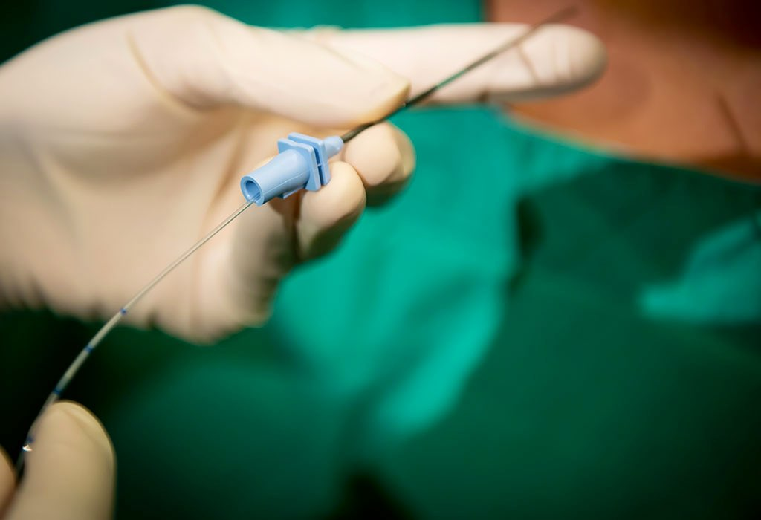
Traditional Labor Epidural Technique
  Controllability
  high-quality analgesia
  lack of effect on the fetus
Contraindications: coagulopathy

Slide 14



Slide 15

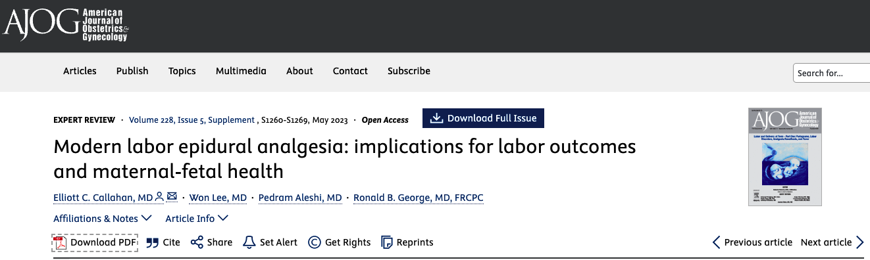

Slide 16
Traditional Labor Epidural Technique
Historical Concerns:
  Increased rates of assisted vaginal delivery?
  Prolonged labor?
  Increased operative delivery rates?
  Based on retrospective and observational studies, prone to bias/less reliable

Slide 17
In high-quality studies, including Cochrane reviews and meta-analyses, epidural analgesia has been suggested to extend the first stage of labor by 30 minutes and the second stage by 15 minutes, when compared with alternative forms of analgesia- argued that it is clinically negligible.
-AJOG

Slide 18
… similar high-quality studies have consistently shown no increased risk of cesarean delivery … such that studies published since 2005 show no higher risk of assisted vaginal delivery …
-AJOG

Slide 19
… neonates of parturients who receive epidural analgesia have been shown to have no worse Apgar scores and more favorable acid-base status …
-AJOG

Slide 20
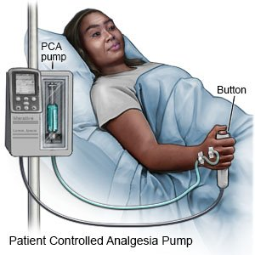
Advancements in Epidural Techniques
Reducing total anesthetic consumption- less motor block
Use of low-concentration local anesthetic solutions
Programmed intermittent epidural bolus (PIEB), patient-controlled epidural analgesia (PCEA), …

Slide 21
Combined Spinal-Epidural (CSE) Analgesia
Advantages vs. traditional EA: faster onset of effective analgesia
No difference vs. low‑dose EA in:
  Prolonged fetal decelerations
  Emergency cesarean delivery
  Pain relief
  Pruritus
  Maternal hypotension
CSE does not increase the incidence of post-dural puncture headache.

Slide 22
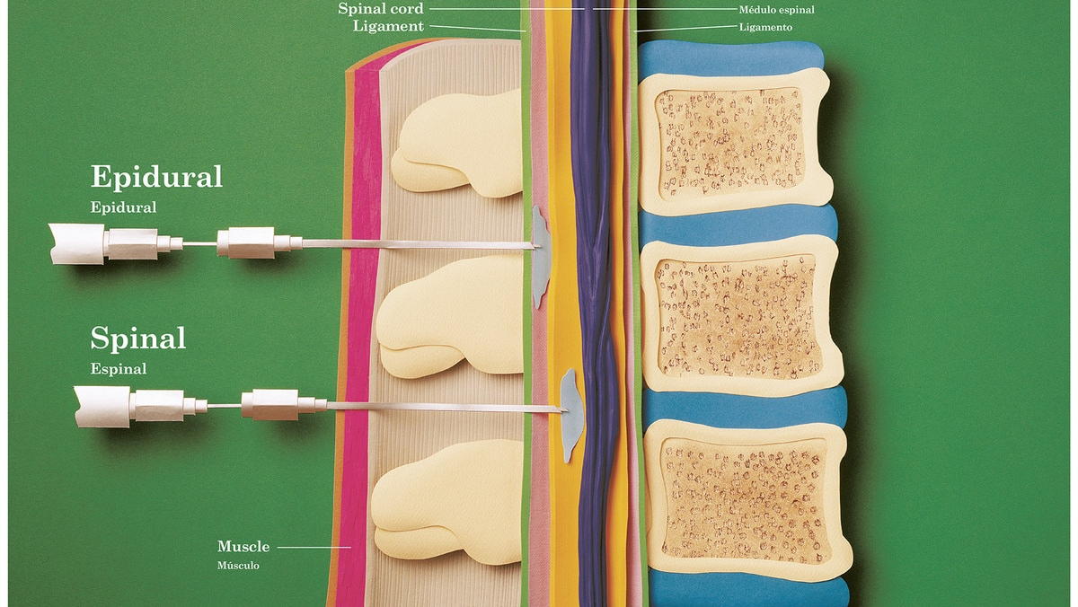

Slide 23
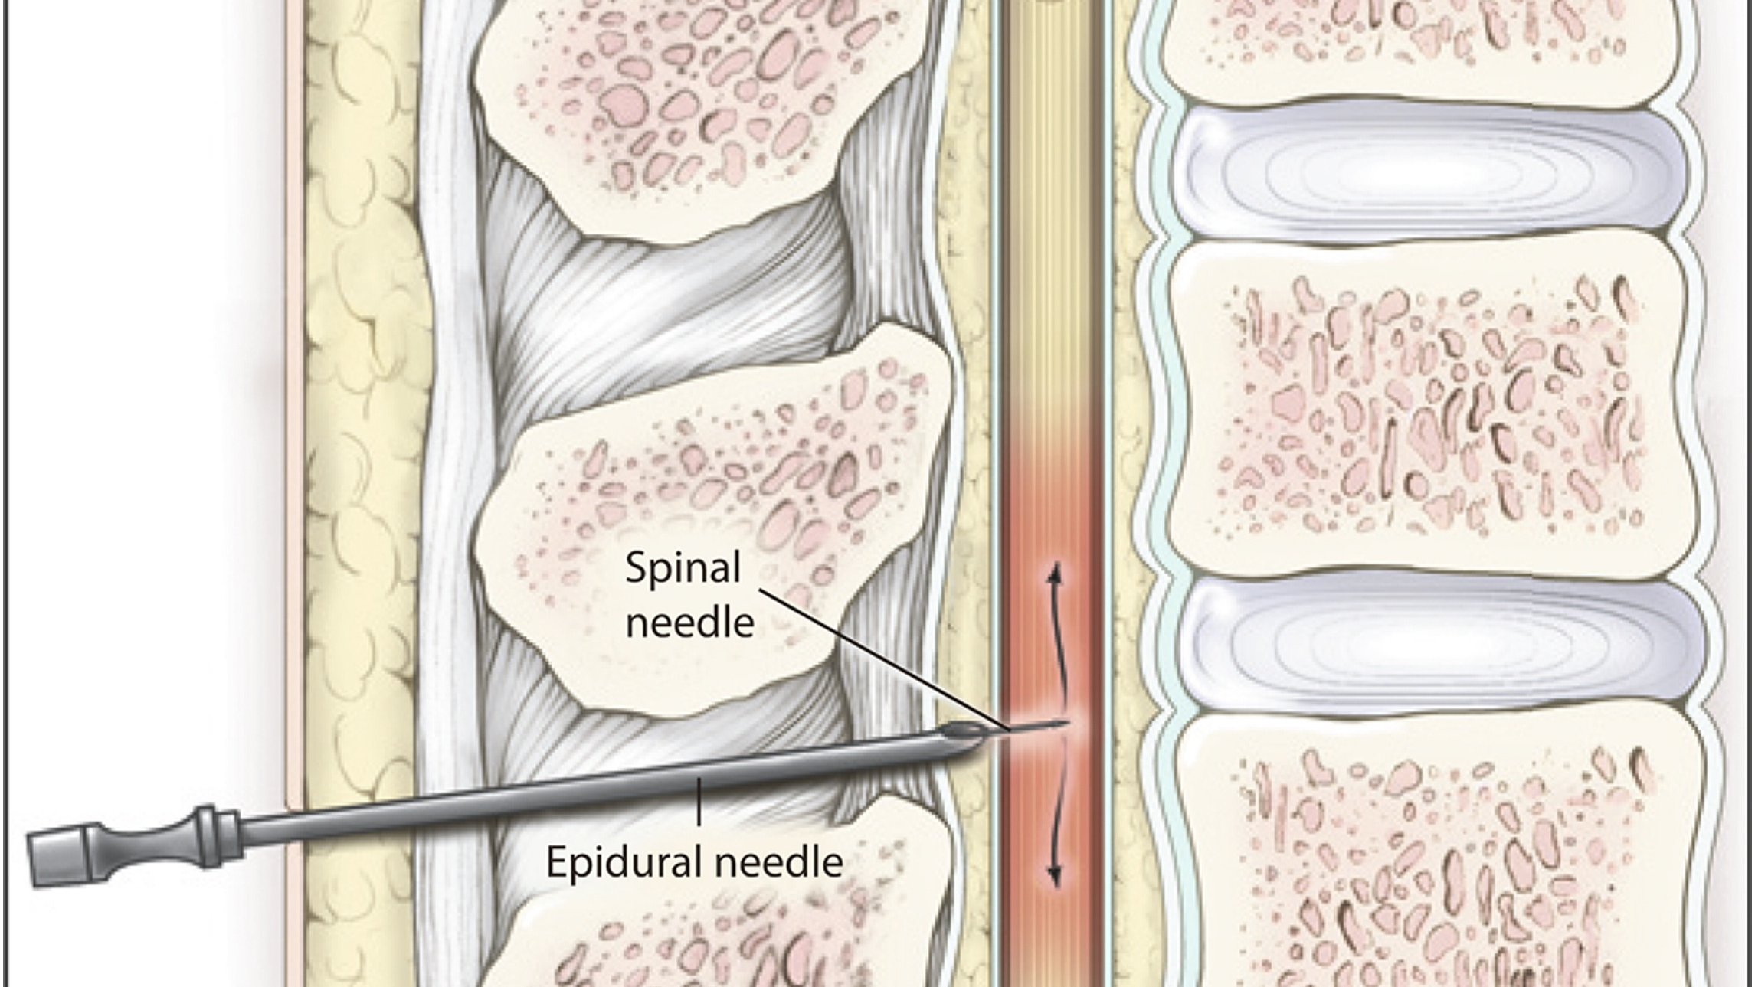

Slide 24

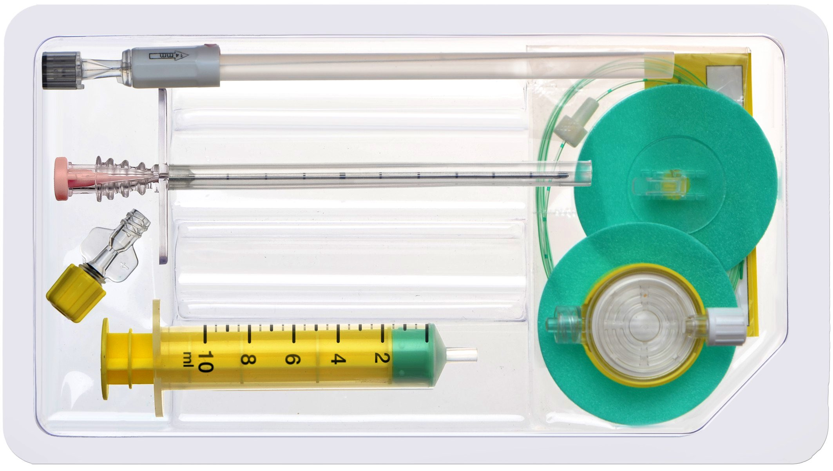
Combined Spinal-Epidural (CSE) Analgesia
CSE concerns: Possibly associated with fetal bradycardia
  Clinical experience: CSE and DPE are safe and effective for the mother and fetus
Allow lower local anesthetic concentrations

Slide 25
Combined Spinal-Epidural (CSE) Analgesia
Intrathecal (initial spinal) dose:
  Low-volume, rapid-acting for first-stage labor analgesia (T10-L1 dermatomes).
  Provides onset within 3-5 minutes, lasting 60-90 minutes.
Epidural phase:
  Test dose first
  then bolus and infusion/maintenance via catheter for prolonged labor, second stage, or breakthrough pain.

Slide 26
Intrathecal (Spinal) Initial Dose (for CSE initiation)
Local Anesthetic | Dose/Volume | Opioid | Dose | Total Volume | Duration/Notes
Bupivacaine 0.25% | 2.5 mg (1 mL) | Fentanyl | 10-25 μg | 2-3 mL | 60-90 min; minimal motor block.
Ropivacaine 0.5% or Levobupivacaine | 2.5-5 mg (0.5-1 mL) | Sufentanil | 5-10 μg | 2 mL | Similar profile; sufentanil faster peak.
Opioid alone (rare, for early labor) | None | Fentanyl | 15-25 μg | 1-2 mL | Short-acting; supplement with epidural if needed.

Slide 27
Epidural Bolus Dose (for breakthrough or second-stage labor)
Solution | Concentration/Details | Examples
Bupivacaine | 0.1-0.125% + Fentanyl 2 μg/mL | 5-10 mL bolus
Levobupivacaine | 0.0625-0.125% + Sufentanil 0.5 μg/mL | 12 mL initial bolus; then 4-8 mL PRN
Ropivacaine | 0.1-0.2% + Opioid | 8-10 mL

Slide 28
Epidural Maintenance Infusion (continuous/PCEA)
Solution | Concentration | Rate | Notes
Levobupivacaine + Sufentanil | 0.0625% (0.625 mg/mL) + 0.5 μg/mL | 8 mL/hour continuous; or PCEA bolus 4-8 mL | Labor standard
Bupivacaine | 0.1% (1 mg/mL) + Fentanyl 2 μg/mL + Epinephrine 2 μg/mL | 8-14 mL/hour | Postoperative extension
Levobupivacaine | 0.125% + Morphine 0.03 mg/mL | 5-10 mL/hour | Alternative
Bupivacaine/Ropivacaine | 0.04-0.125% + Fentanyl/Sufentanil | 6-12 mL/hour | Steady control; clinician top-ups for breakthrough

Slide 29
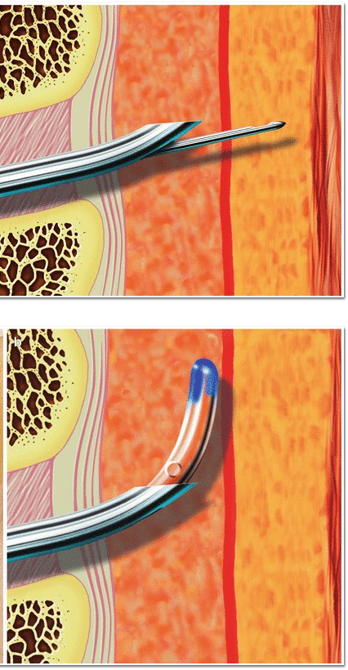
Dural Puncture Epidural (DPE)
Intentional dural puncture facilitates subarachnoid spread of epidural drugs
Proposed advantages
  Improved central neuraxial block
  ↓ EA‑related issues: slow onset, unilateral block, sacral sparing
  ↓ CSE‑related effects: fetal bradycardia, pruritus

Slide 30
Dural Puncture Epidural (DPE)
No difference vs EA in:
  Spontaneous vaginal birth
  Cesarean delivery
  Unilateral block
  Motor block
  Lower incidence of nausea/vomiting with DPE

Slide 31
Alternatives to Epidural Analgesia

Slide 32
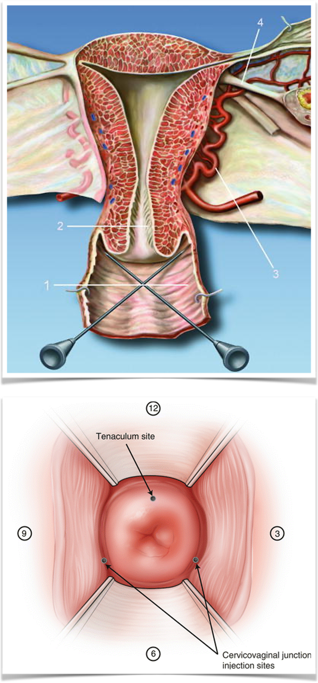
Paracervical Block
Injection of local anesthetic into the submucosal layer of the vaginal fornix.
Effective for uterine contraction pain.
Not effective for the second stage of labor.
Complications:
  Fetal bradycardia
  Local anesthetic toxicity

Slide 33
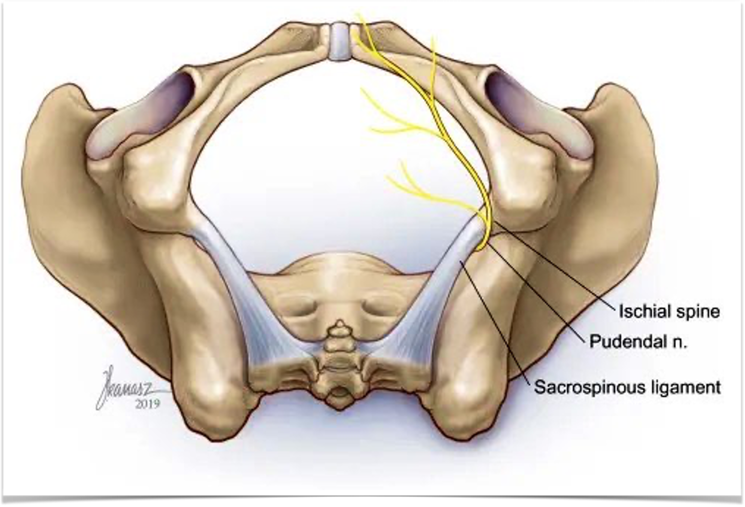
Pudendal Nerve Block
Effective for the second stage of labor
Not effective for uterine contractions
Complications:
  Bleeding
  Infection
  Local anesthetic toxicity

Slide 34
Spinal Analgesia
Limitations:
  Fixed duration: 1–2 hours of analgesia, suitable for late-stage labor
  Risk of headache
Local anesthetic: Bupivacaine or ropivacaine (2–4 mg)
Opioid: Fentanyl (10–15 μg) or sufentanil (1–4 μg)

Slide 35
Continuous Spinal Analgesia (CSA)
Analgesia via intrathecal catheter
Potential advantages:
  Lower drug requirements
  Precise, titratable analgesia
  Improved hemodynamic stability

Slide 36
Continuous Spinal Analgesia (CSA)
Clinical implications:
  Best considered on a case‑by‑case basis
  After an inadvertent dural puncture during attempted epidural placement.
  For patients with difficult anatomy (e.g., morbid obesity) or concerns about epidural medication spread (e.g., prior spinal surgery).
  When repeated epidural attempts fail, or analgesia is inadequate.

Slide 37
Continuous Spinal Analgesia (CSA)
Dosing:
  Starting bolus: Bupivacaine 2–3 mg + fentanyl 10 μg
  Infusion: Bupivacaine 0.0625% + fentanyl 2 μg/ml at 2–3 ml/h
  Supplemental bolus: Bupivacaine 1–3 mg + fentanyl 10–20 μg

Slide 38
Advantages | Disadvantages | Obstetric side effects | Maternal side effects | Fetal side effects
EA | Pain relief, less anxiety, reduction of catecholaminergic burst (tocolytic action and risk factor for postpartum depression), possible conversion to epidural anesthesia in emergency. | Slower analgesia onset, high anesthetic consumption, high hospital costs, higher incidence of motor block, higher catheter failure and replacement rates, asymmetric block. | Second labor stage prolongation. | Self-limiting hypotension. | Self-limiting bradycardia.
CSE | Faster analgesia onset, greater maternal satisfaction rate, lower catheter failure and replacement rates, possible conversion to epidural anesthesia in emergency. | At higher anesthetic concentrations: higher motor block rate. Itching (with intrathecal opioids) | Second labor stage prolongation. | At higher anesthetic concentrations: increased maternal hypotension, headache, nausea and vomiting. | At higher anesthetic concentrations: transient fetal bradycardia.
DPE | Faster analgesia onset, maternal satisfaction, lower catheter failure, possible conversion to epidural anesthesia in emergency. | PDPH risk. | Second stage prolongation. | Less cardiovascular side effects incidence. | Less cardiovascular side effects incidence.
CSA | Rapid onset, symmetrical sensory blockade, low anesthetic dosages and possible conversion to spinal anesthesia in emergency. | PDPH, cauda equina and transient neurological syndrome risk. | Lower prolongation of second stage. | Higher maternal satisfaction in the first 24 h postpartum, hemodynamic stabilization in hypertensive patients.

Slide 39
Timing of labor analgesia

Slide 40
Two approaches
  Early initiation: cervical dilation < 4 cm
  Late initiation: cervical dilation ≥ 4 cm
Cochrane meta‑analysis, no difference in:
  Cesarean section rate
  Maternal or fetal outcomes
Some studies suggest a 6 cm dilation is proposed as the optimal threshold.
Guideline recommendation (ACOG):
  Maternal request alone is a sufficient indication
  No need to delay analgesia if no contraindication

Slide 41
Neuraxial block‐related complications

Slide 42
Maternal Effects
Epidural hematoma
  Extremely rare: ~1:170,000
  Risk ↑ with thrombocytopenia/coagulopathy (e.g. HELLP)- Epidural acceptable if platelets ≥ 70–75 × 10⁹/L
Post‑dural puncture headache (PDPH)
  Incidence: <2%–40% (center and technique dependent)

Slide 43
Maternal Effects
Maternal hypotension
  Due to sympathetic blockade → vasodilation → functional hypovolemia
  Usually transient & treatable
  Rarely harmful if promptly corrected
Epidural‑related maternal fever (ERMF)
  Incidence: 15–25%
  Non‑infectious, inflammatory mechanism
  Resolves rapidly after delivery

Slide 44
Fetal & Neonatal Effects
Fetal heart rate changes
  Bradycardia, decelerations, ↓ variability- mild, transient, reversible
  Mechanisms:
    Maternal hypotension
    Rapid pain relief → catecholamine imbalance → uterine hypertonia

Slide 45
Most maternal and fetal effects of neuraxial labor analgesia are predictable, transient, and manageable, with overall benefits generally outweighing the risks when administered appropriately and monitored closely.

Slide 46
Post-C/S Delivery Analgesia

Slide 47


Paravertebral Block
Erector Spinae Plane Block (ESPB)
Quadratus lumborum block (QLB)
Quadro-iliac plane block
Transversus Abdominis Plane (TAP) Block
Ilio-inguinal/Iliohypogastric (ILIH) Block
Rectus Sheath Block

Slide 48
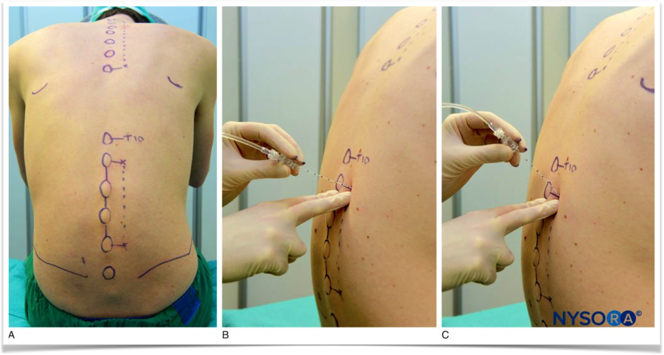
Paravertebral Block
Injecting an anesthetic adjacent to the thoracic vertebrae.
Effective for the second stage of labor (case reports)
Post-C/S delivery analgesia

Slide 49
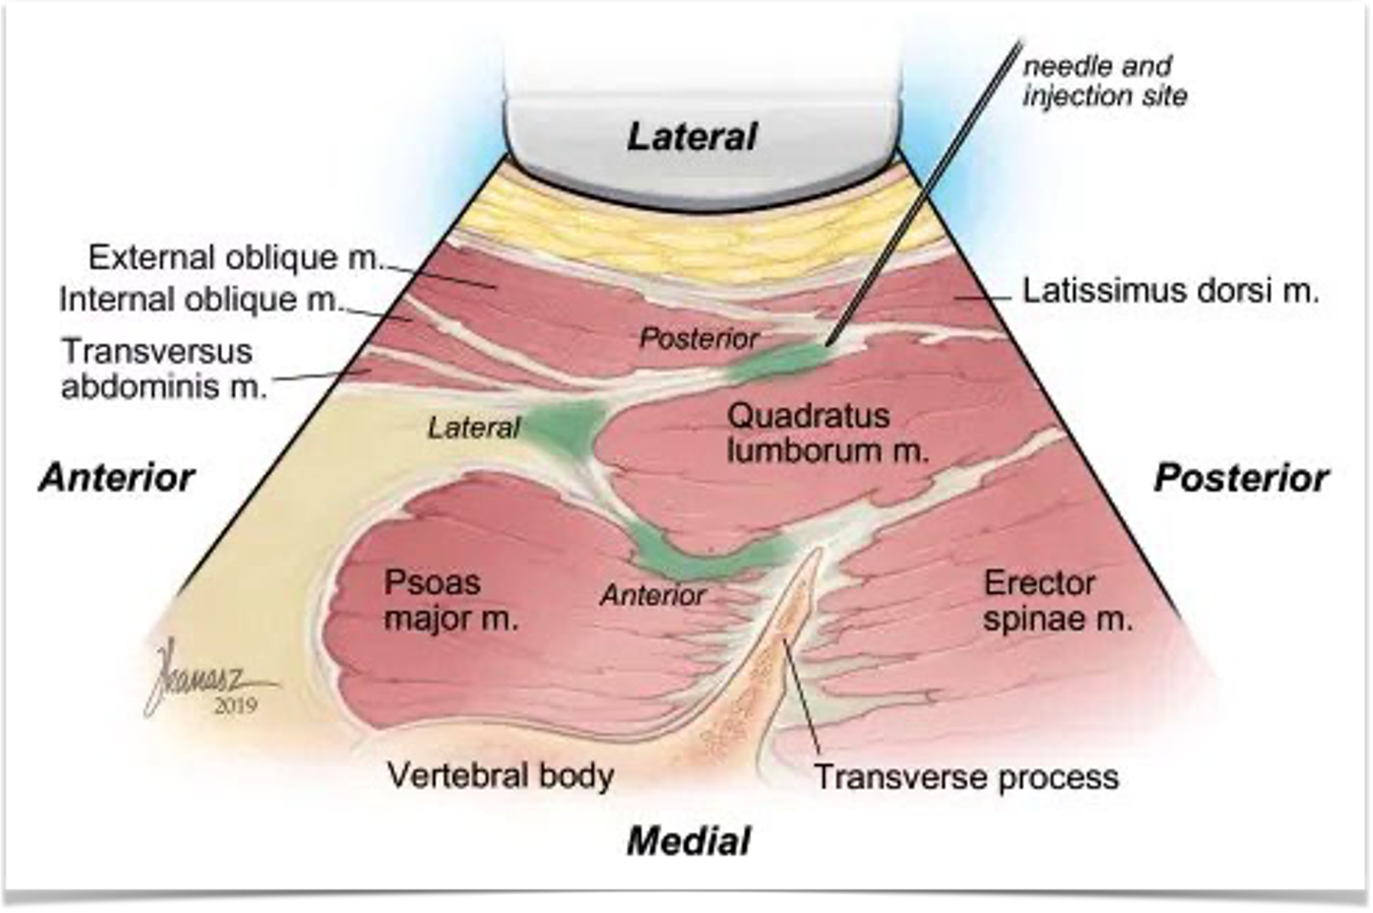
Quadratus Lumborum Block (QLB)
Targets the quadratus lumborum muscle.
Effective for C/S pain relief.
Also used in various surgical settings

Slide 50

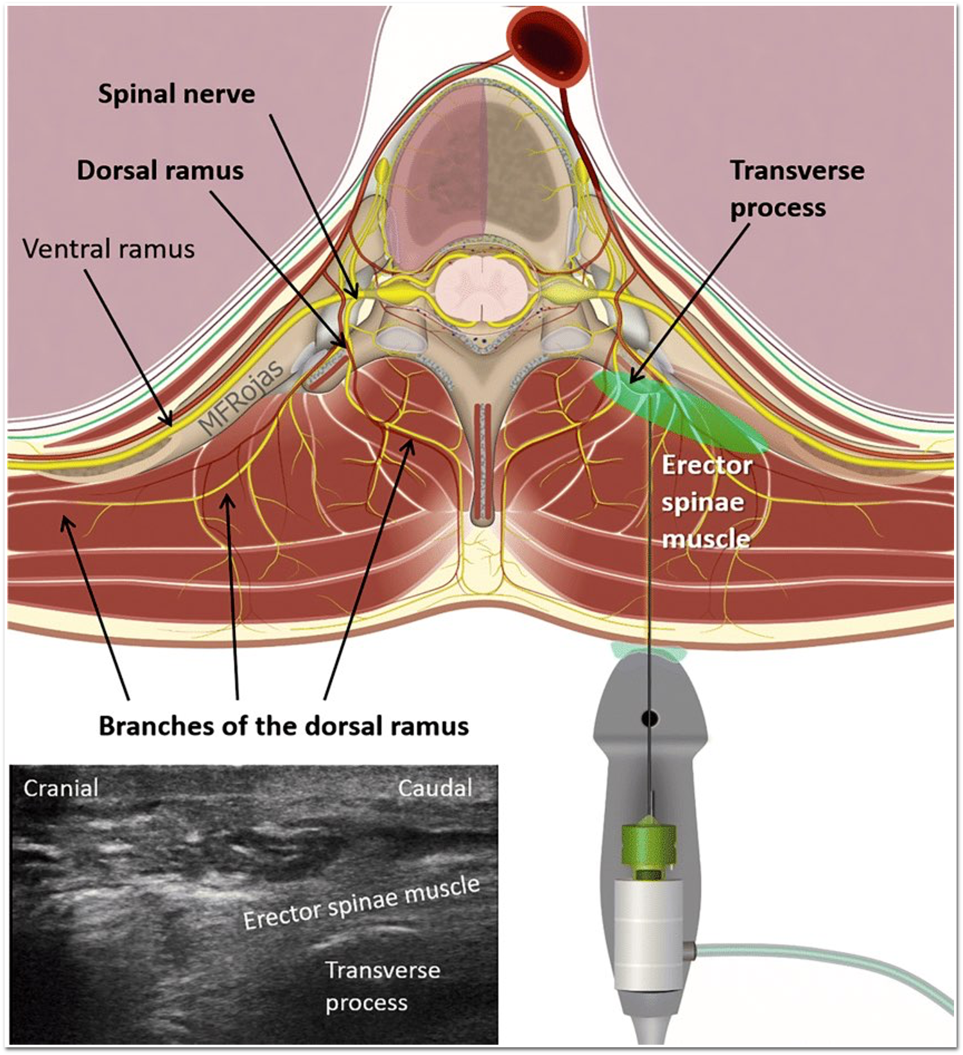

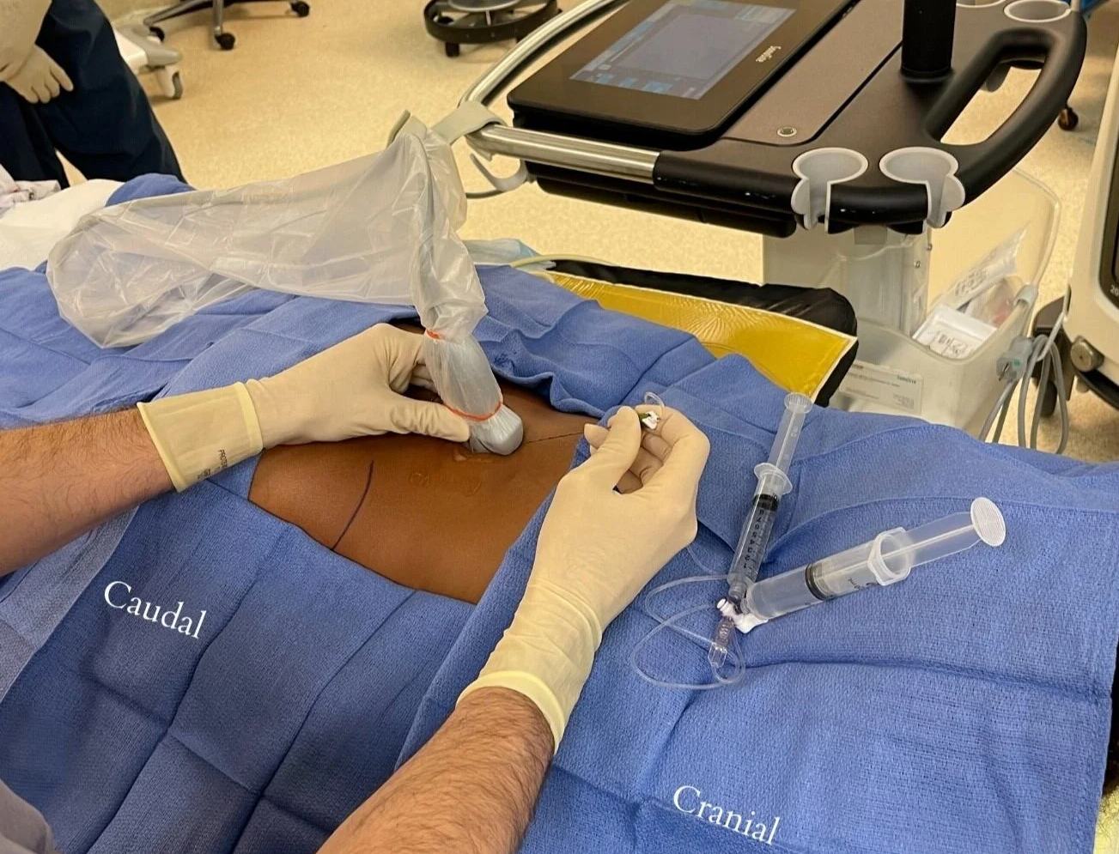
Erector Spinae Plane Block (ESPB)
Injecting anesthetic between the transverse process and the erector spinae muscle.
Effective for labor pain relief (few cases)
Also used in various surgical settings

Slide 51

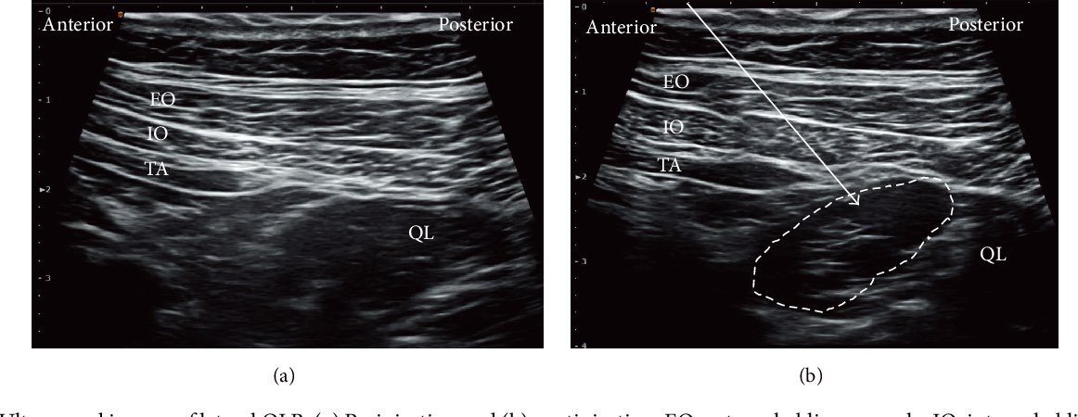
Ultrasound Guidance
Crucial in regional anesthesia
Benefits: improves accuracy and safety
Precise needle placement is essential to avoid complications.

Slide 52
Other than technical skills…

Slide 53
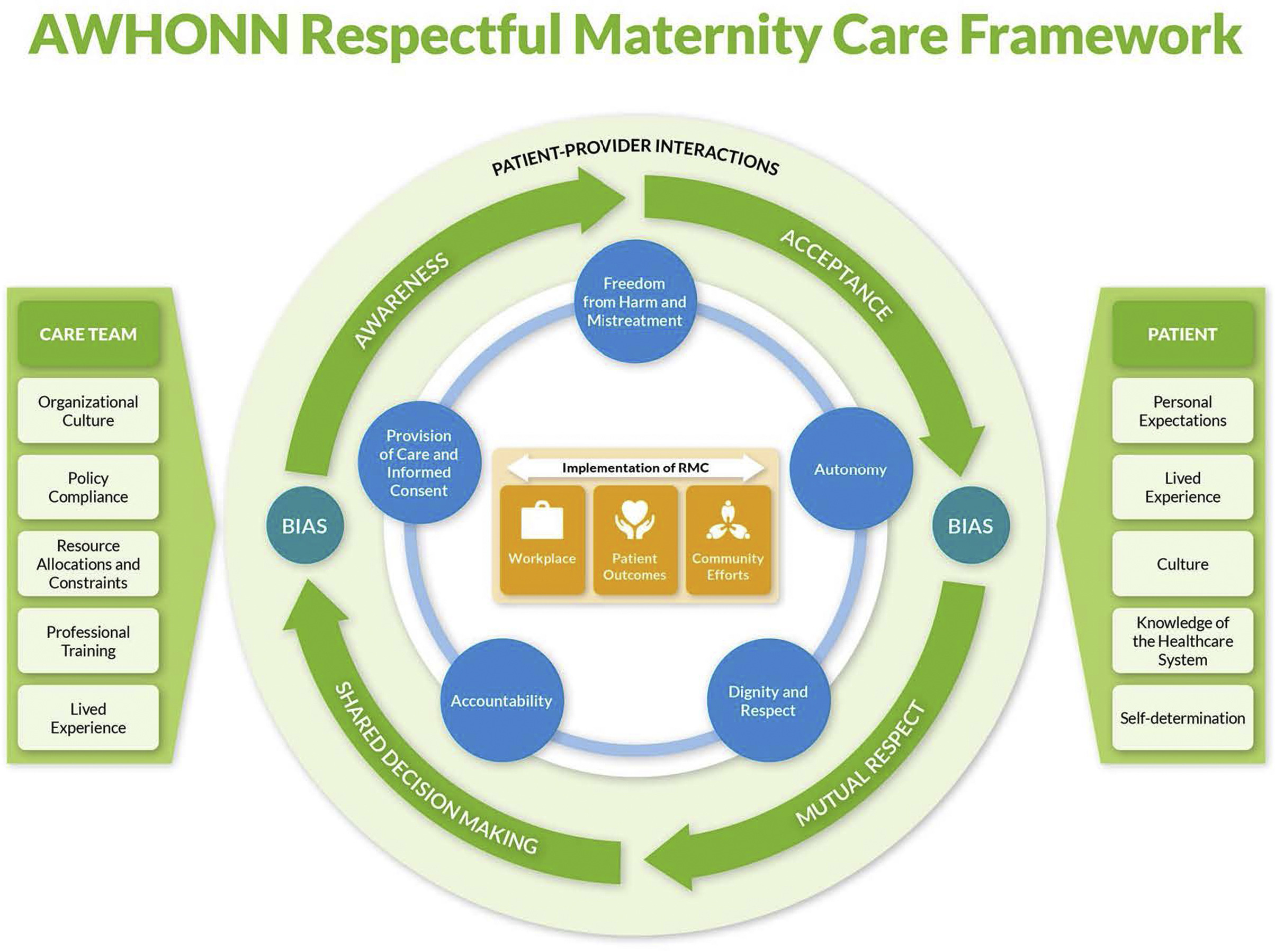

Slide 54


Respectful Maternity Care (RMC)
Equal importance is given to:
  Competent and motivated staff
  Pre‑established referral systems
  Continuous emotional support
RMC applies regardless of:
  Socio‑economic status
  Race or ethnicity
  Cultural background

Slide 55


RMC
Woman‑centered rights
  Free and autonomous choice of pain relief
  Informed consent
  Communication that is simple, effective, and culturally acceptable
  Access to multiple pain‑relief options
  Respect for refusal of analgesia

Slide 56


RMC – Environment & Implementation
Positive childbirth environment
  Private or personal delivery room
  Presence of a companion of choice (partner, relative, friend, or doula)
  Continuous care by a dedicated midwife
Institutional responsibilities
  Adopt high‑quality intrapartum care models

Slide 57

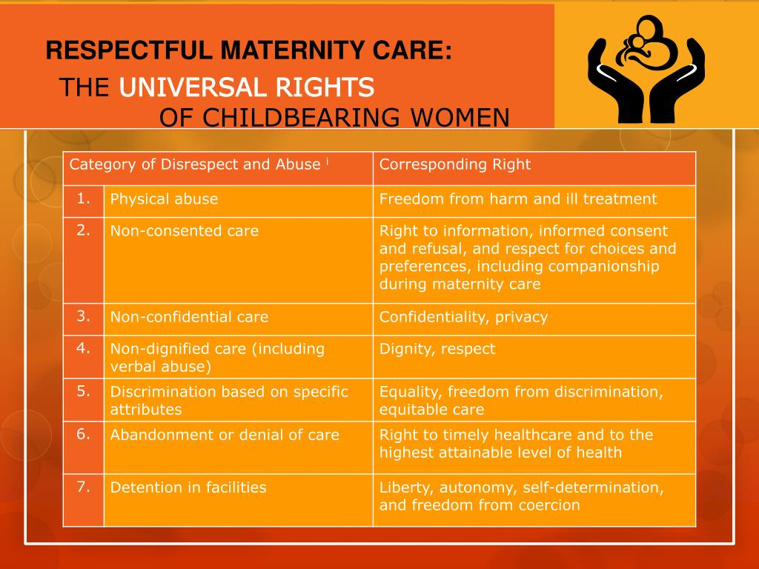
RMC – Environment & Implementation
Promote:
  Respectful communication
  Maternal choice of position
  Appropriate pain‑relief techniques
Avoid unnecessary interventions:
  Routine episiotomy
  Fundal pressure
  Routine amniotomy

Slide 58


RMC – Environment & Implementation
Strategies to promote RMC
  Education on maternal and fetal rights
  Online outreach programs
Institutional meetings involving:
  Health professionals
  Mothers sharing childbirth experiences

Slide 59
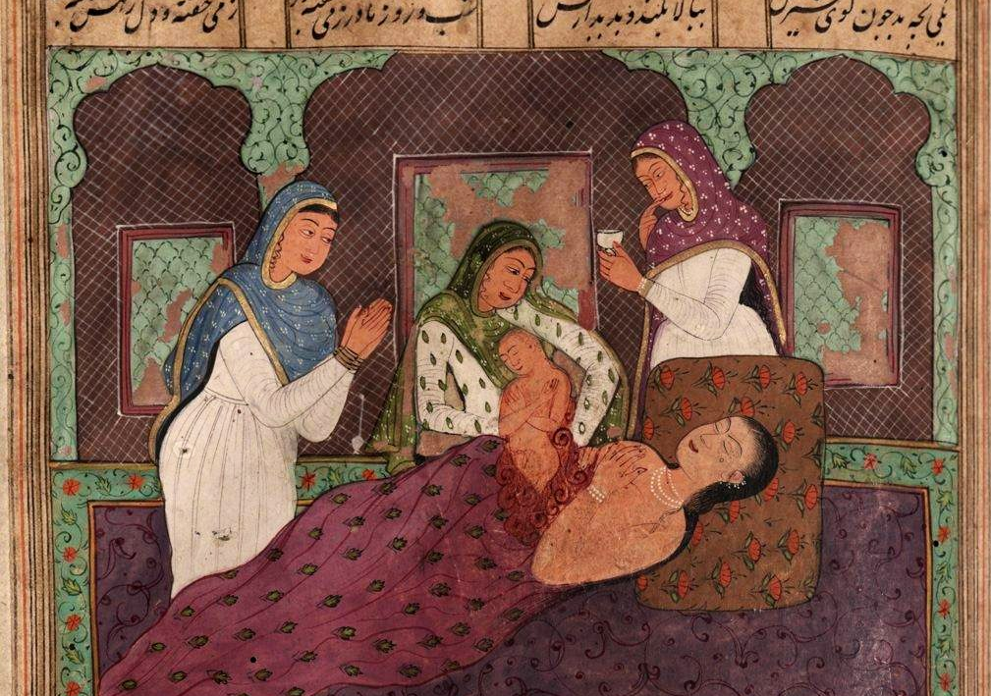


Slide 60
References

Slide 61
J Clin Monit Comput. 2000;16(8):597-608. doi: 10.1023/a:1012268617009. Neonatal monitoring after maternal fentanyl analgesia in labor. E M Nikkola 1, T J Jahnukainen, U U Ekblad, P O Kero, M A Salonen
Reg Anesth Pain Med. 2016 Mar-Apr;41(2):140-5. doi: 10.1097/AAP.0000000000000355. Ultrasound-Guided Pudendal Nerve Block at the Entrance of the Pudendal (Alcock) Canal: Description of Anatomy and Clinical Technique. Thomas Fichtner Bendtsen 1, Teresa Parras, Bernhard Moriggl, Vincent Chan, Lilli Lundby, Steen Buntzen, Karoline Dalgaard, Birgitte Brandsborg, Jens Børglum
Reg Anesth Pain Med. 2016 Sep-Oct;41(5):621-7. doi: 10.1097/AAP.0000000000000451. The Erector Spinae Plane Block: A Novel Analgesic Technique in Thoracic Neuropathic Pain. Mauricio Forero 1, Sanjib D Adhikary, Hector Lopez, Calvin Tsui, Ki Jinn Chin
Anesthesiology. 2002 Aug;97(2):521; author reply 521-2. doi: 10.1097/00000542-200208000-00037. The use of a nerve stimulator for thoracic paravertebral block. Scott A Lang
Front Surg. 2022 Apr 1;9:674987. doi: 10.3389/fsurg.2022.674987. Efficacy of Transversus Abdominis Plane Block in Patients After Laparoscopic Radical Cervical Cancer Surgery. Xiaoyu Ma 1,†, Yi Gao 1,†, Jing Wang 2, Zhen Wu 3, Huasu Shen 1, Ping Wang 1,*

Slide 62
Anaesth Rep. 2020 Nov 12;8(2):e12083. doi: 10.1002/anr3.12083. The erector spinae plane block for obstetric analgesia: a case series of a novel technique. J S Vilchis Rentería 1, P W H Peng 2, M Forero 3,✉
A A Pract. 2020 May;14(7):e01193. doi: 10.1213/XAA.0000000000001193. Posterior Quadratus Lumborum Block for Labor Analgesia: A Case Report. Johanna Blair de Haan 1, Subhan Tabba, Linden O Lee, Semhar Ghebremichael, Sudipta Sen, Daniel Shoham, Nadia Hernandez
ANESTHESIA IN OBSTETRICS. Regional methods of anesthesia in labor pain relief: a systematic review. Published 28.10.2022. O.A. Makcharin+Elena A. Lebedeva+N.V. Kochubeinik+
Br J Anaesth. 2009 Apr;102(4):534-9. doi: 10.1093/bja/aep015. Epub 2009 Feb 24. Ultrasound-guided paravertebral puncture and placement of catheters in human cadavers: an imaging study. C Luyet 1, U Eichenberger, R Greif, A Vogt, Z Szücs Farkas, B Moriggl
Reg Anesth Pain Med . 2016 Nov/Dec;41(6):757-762. doi: 10.1097/AAP.0000000000000495. Quadratus Lumborum Block Versus Transversus Abdominis Plane Block for Postoperative Pain After Cesarean Delivery: A Randomized Controlled Trial. Rafael Blanco 1, Tarek Ansari, Waleed Riad, Nanda Shetty

Slide 63
Can Fam Physician. 2007 Mar;53(3):437–442. Single-dose intrathecal analgesia to control labour pain. Is it a useful alternative to epidural analgesia? RG Minty, Len Kelly, Alana Minty, DC Hammett
Anesth Pain Med. 2021 Mar 1;11(1):e108335. doi: 10.5812/aapm.108335. Comparison of Spinal Versus Epidural Analgesia for Vaginal Delivery: A Randomized Double Blinded Clinical Trial. Farnad Imani, Sarah Lotfi, Javad Aminisaman, Afshar Shahmohamadi, Abbas Ahmadi
OBSTETRIC ANESTHESIOLOGY: RESEARCH REPORT. Continuous Spinal Analgesia for Labor and Delivery, An Observational Study with a 23-Gauge Spinal Catheter. Tao, Weike MD*; Grant, Erica N. MD, MSc*; Craig, Margaret G. MD*; McIntire, Donald D. PhD†; Leveno, Kenneth J. MD
Continuous Spinal Analgesia for Labor and Delivery. Tao, Weike MD*; Grant, Erica N. MD, MSc*; Craig, Margaret G. MD*; McIntire, Donald D. PhD†; Leveno, Kenneth J. MD†. Anesthesia & Analgesia 121(5):p 1290-1294, November 2015. | DOI: 10.1213/ANE.0000000000000903
Single-dose intrathecal analgesia: a safe and effective method of labor analgesia for parturients in low resource areas. Gian Chauhan, Poonam Samyal & Anshit Abhi Pathania. Ain-Shams Journal of Anesthesiology. volume 12, Article number: 23 (2020)

Slide 64
Chau, Anthonya,b,c; Tsen, Lawrence C.d. Neuraxial initiation techniques for labor analgesia: Comparative insights on standard epidural, combined spinal-epidural and dural puncture epidural analgesia. Current Opinion in Anesthesiology 38(3):p 195-201, June 2025. | DOI: 10.1097/ACO.0000000000001487
Coviello A, Iacovazzo C, Frigo MG, Ianniello M, Cirillo D, Tierno G, de Siena AU, Buonanno P, Servillo G. Technical aspects of neuraxial analgesia during labor and maternity care: an updated overview. J Anesth Analg Crit Care. 2025 Jan 29;5(1):6. doi: 10.1186/s44158-025-00224-3. PMID: 39881415; PMCID: PMC11780834.
BJA REVIEW ARTICLE. Volume 20, Issue 3P96-102March 2020. Open Archive. Neuraxial analgesia for labour. B. Shatil1 ∙ R. Smiley2 rms7@cumc.columbia.edu
American Journal of Obstetrics & gynecology volume 228, Issue 5, Supplement S1260-S1269May 2023. Modern labor epidural analgesia: implications for labor outcomes and maternal-fetal health

Slide 65
Thank You!

