Slide 1

Regional Analgesia in Painless Childbirth
Dariush Abtahi, MD
Associate Professor, Clinical Research and Development Unit, Imam Hossein Hospital, Department of Anesthesiology, Shahid Beheshti University of Medical Sciences, Tehran, Iran
E-mail: drdariushabtahi@yahoo.com, d.abtahi@sbmu.ac.ir
Advantages and Disadvantages

Slide 2
Introduction
Widespread in Developed Countries
Over the past 3-4 decades, there has been a notable increase in the following aspects:
  Enhanced focus on women's healthcare
  Availability of anesthesia personnel
  Significant advancements in analgesia methods
Major differences in the percentage of women receiving neuraxial analgesia across different countries:
  USA: 65%, UK: 33%, Japan: 5%.

Slide 3

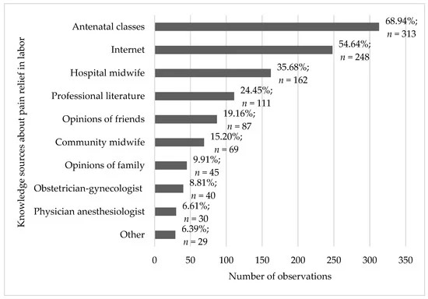
Women’s Knowledge about Pharmacological and Non-Pharmacological Methods of Pain Relief in Labor
by Jakub Pietrzak 1,*,Wioletta Mędrzycka-Dąbrowska 2,Andrzej Wróbel 3 andMagdalena Emilia Grzybowska 4
Healthcare 2023, 11(13), 1882; https://doi.org/10.3390/healthcare11131882

Slide 4

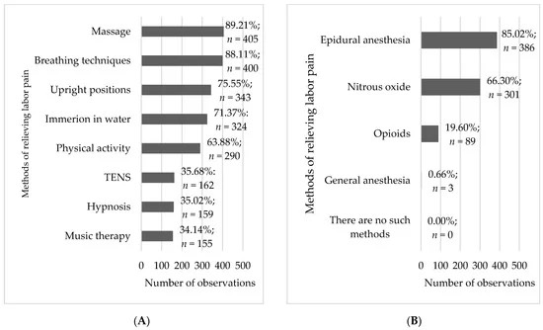
Frequency analysis of non-pharmacological (A) and pharmacological (B) methods of relieving labor pain (n = 454).

Slide 5
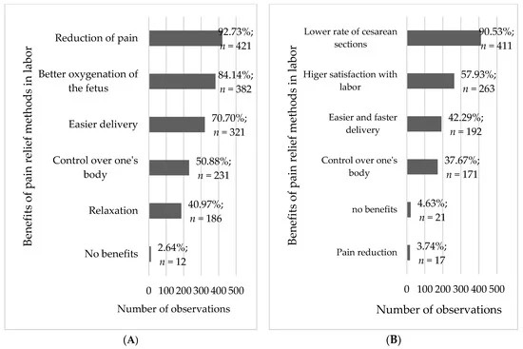
Frequency analysis of benefits of using non-pharmacological (A) and pharmacological (B) methods of pain relief in labor (n = 454).

Slide 6
Epidural Analgesia

Slide 7
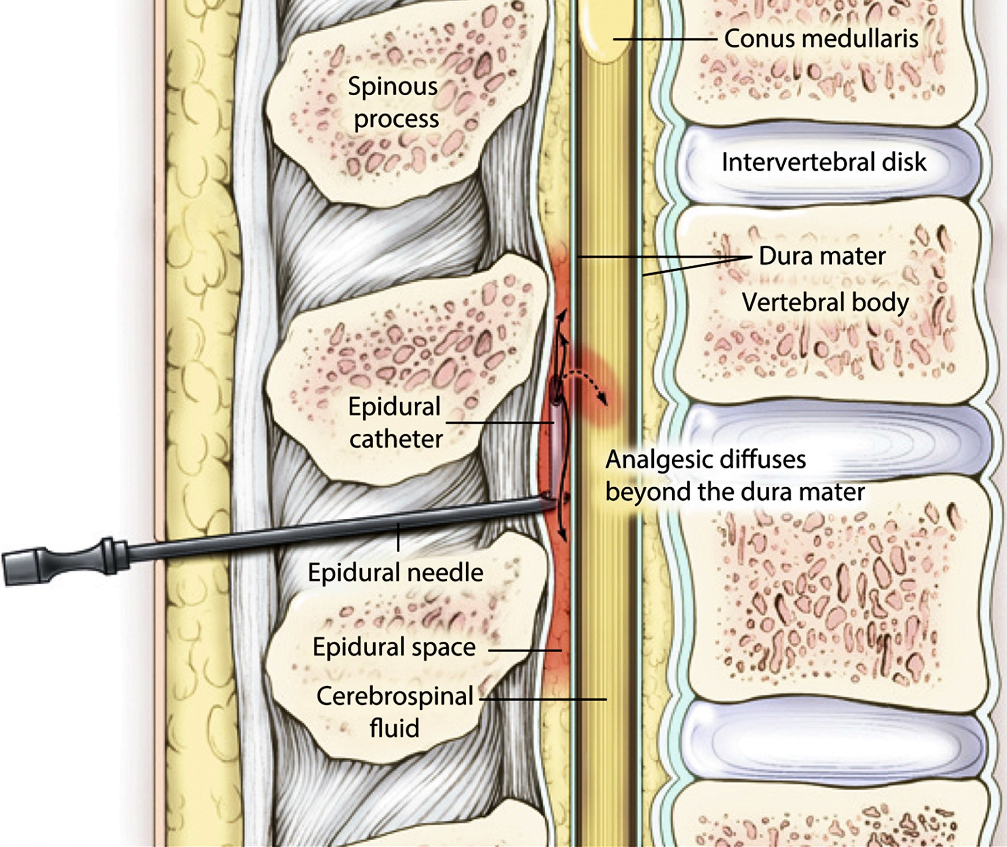
Epidural Analgesia - The Gold Standard
The gold standard for labor pain relief.
Injecting anesthetics into the epidural space.
Controllability, high-quality analgesia, lack of effect on the fetus
Contraindications: coagulopathy

Slide 8
Epidural Analgesia - The Gold Standard
American Journal of Obstetrics & gynecology volume 228, Issue 5, Supplement S1260-S1269May 2023
Modern labor epidural analgesia: implications for labor outcomes and maternal-fetal health
Historical Concerns:
  prolonged labor
  increased operative delivery rates
  retrospective and observational studies, which are prone to bias and less reliable
High-Quality Evidence:
  Cochrane reviews and meta-analyses suggest epidural analgesia may:
    Extend the first stage of labor by ~30 minutes.
    Extend the second stage of labor by ~15 minutes.
clinically negligible

Slide 9
Epidural Analgesia - The Gold Standard (cont.)
American Journal of Obstetrics & gynecology volume 228, Issue 5, Supplement S1260-S1269May 2023
Modern labor epidural analgesia: implications for labor outcomes and maternal-fetal health
Mode of Delivery and Epidural Analgesia:
  Earlier forms of epidural analgesia were linked to a higher risk of assisted vaginal delivery
  No increased risk of cesarean delivery associated with modern techniques.
Advancements in Epidural Techniques:
  Reducing total anesthetic consumption- less motor block
  Use of low-concentration local anesthetic solutions
  Programmed intermittent epidural bolus (PIEB) and patient-controlled epidural analgesia (PCEA).

Slide 10
Epidural Analgesia - The Gold Standard (cont.)
American Journal of Obstetrics & gynecology volume 228, Issue 5, Supplement S1260-S1269May 2023
Modern labor epidural analgesia: implications for labor outcomes and maternal-fetal health
Maternal Implications of Labor Epidural Analgesia:
  Transient hypotension:
    Common with initiation, may require fluid or vasopressor therapy.
    Not linked to adverse maternal or fetal outcomes.
  Maternal fever:
    Higher incidence in parturients receiving neuraxial anesthesia, likely noninfectious.
    No association with adverse neonatal outcomes.
  Fetal and Neonatal Implications:
    No worse Apgar scores.
    More favorable acid-base status compared to neonates of mothers without epidural analgesia.

Slide 11
Alternatives to Epidural Analgesia

Slide 12

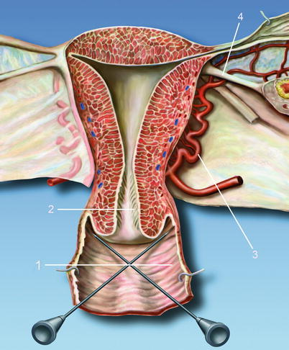

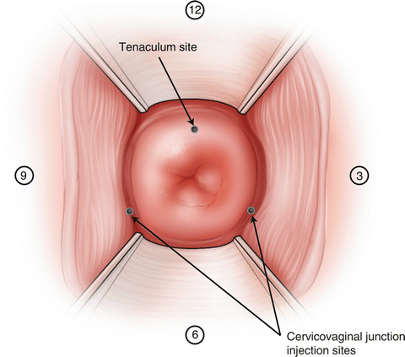
Paracervical Block
Injection of local anesthetic into the submucosal layer of the vaginal fornix.
Effectiveness:
  Effective for uterine contraction pain.
  Not effective for the second stage of labor.
Complications:
  Fetal bradycardia
  Local anesthetic toxicity

Slide 13

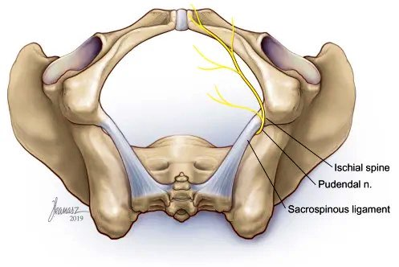
Pudendal Nerve Block
Effectiveness:
  Effective for the second stage of labor
  Not effective for uterine contractions
Complications:
  Bleeding
  Infection
  Local anesthetic toxicity.
Contraindications:
  Infection or presence of perianal inflammation

Slide 14
Spinal Analgesia

Slide 15
Spinal Analgesia
Limitations:
  Fixed duration: Single-shot techniques provide only temporary relief.
  Risk of headache: High likelihood with large-bore needles used for catheter placement in the subarachnoid space.
Use in Late-Stage Labor:
  When delivery is imminent, a single injection can be effective:
    Local anesthetic: Bupivacaine or ropivacaine (2–4 mg).
    Opioid: Fentanyl (10–15 μg) or sufentanil (1–4 μg).
Administered using a 25 or 27-gauge pencil-point spinal needle.
Provides 1–2 hours of analgesia, suitable for late-stage labor.

Slide 16
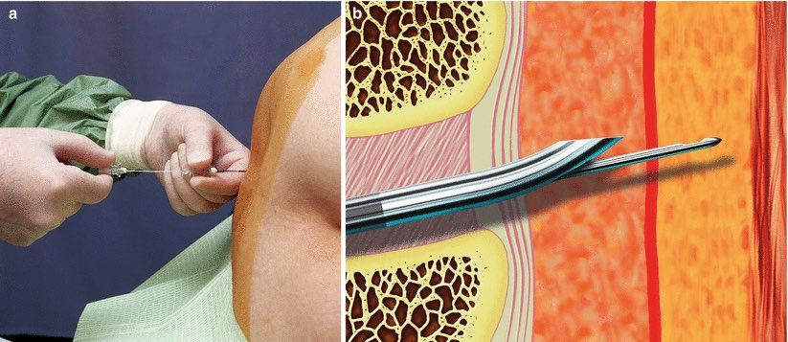
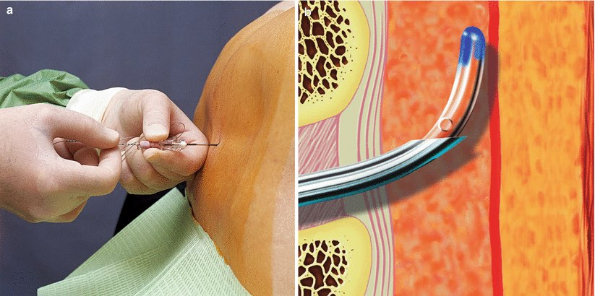
Combined Spinal-Epidural (CSE) Analgesia
More rapid, reliable, and effective analgesia compared to epidural alone.
Denser block
Lower pain scores
Despite dural puncture, CSE does not increase the incidence of post-dural puncture headache (PDPH).

Slide 17
Continuous Spinal Analgesia (CSA)
A catheter is placed in the intrathecal space for infusion.
Common uses:
  After an inadvertent dural puncture during attempted epidural placement.
  For patients with difficult anatomy (e.g., morbid obesity) or concerns about epidural medication spread (e.g., prior spinal surgery).
  When repeated epidural attempts fail or analgesia is inadequate.
Advantages of CSA:
  More reliable analgesia: Medication enters the CSF directly.
  Catheter position verification: CSF can be aspirated to confirm placement.

Slide 18
Continuous Spinal Analgesia (CSA) (cont.)
Dosing:
  Spinal doses are 10–15% of epidural doses.
  Starting bolus: Bupivacaine 2–3 mg + fentanyl 10 μg.
  Infusion: Bupivacaine 0.0625% + fentanyl 2 μg/ml at 2–3 ml/h (comparable to epidural dosing of 12–20 ml/h).
  No patient-controlled dosing due to safety concerns.
  Supplemental bolus: Bupivacaine 1–3 mg + fentanyl 10–20 μg, administered manually by physicians.

Slide 19
Continuous Spinal Analgesia (CSA) (cont.)
Safety Concerns:
  Infection risk: Higher and more severe if the fluid path is contaminated.
  CSF loss: Disconnection can lead to serious consequences.
Communication: All practitioners must be aware of the intrathecal catheter to avoid catastrophic errors (e.g., administering an epidural bolus dose).
  Labeling: Clearly label the catheter, pump, and patient’s room, and inform the nurse/midwife and patient.
  Post-dural puncture headache (PDPH): Significant risk when using large-bore needles (17–18 G) to insert catheters (19–20 G).

Slide 20
Post-C/S Delivery Analgesia

Slide 21
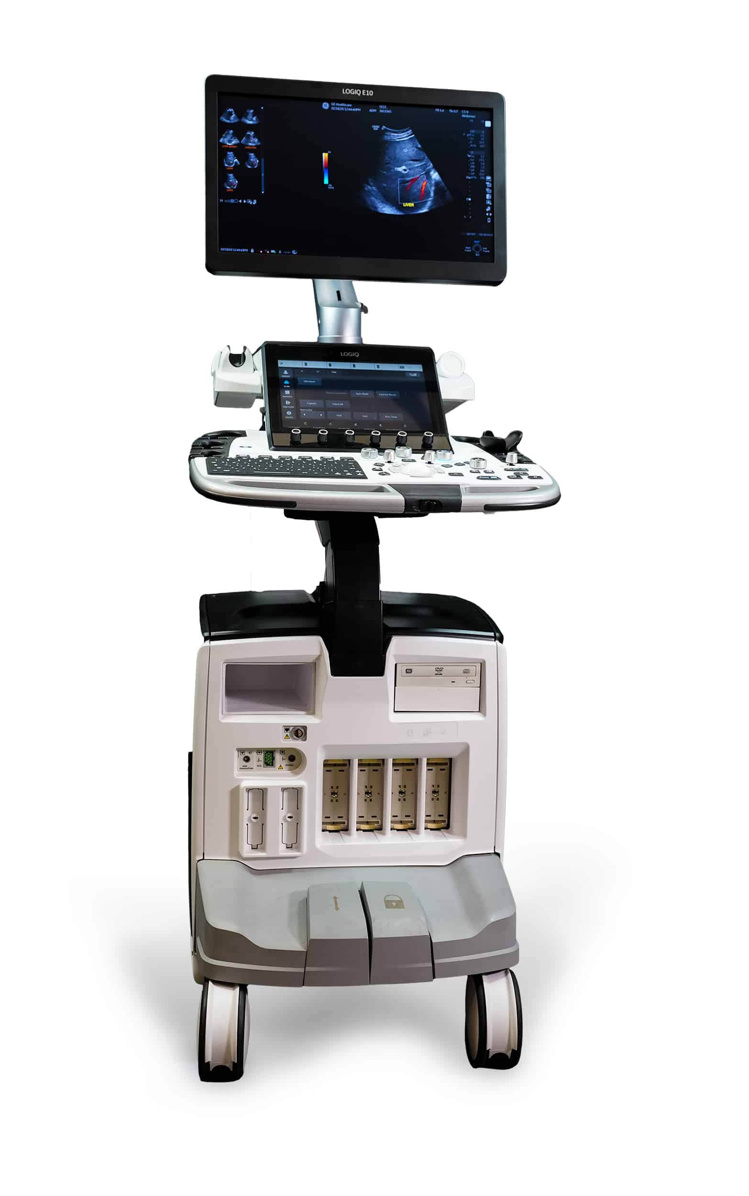
Post-C/S delivery analgesia
Paravertebral Block
Erector Spinae Plane Block (ESPB)
Quadratus lumborum block (QLB)
Quadro-iliac plane block
Transversus Abdominis Plane (TAP) Block
Ilio-inguinal/Iliohypogastric (ILIH) Block
Rectus Sheath Block

Slide 22

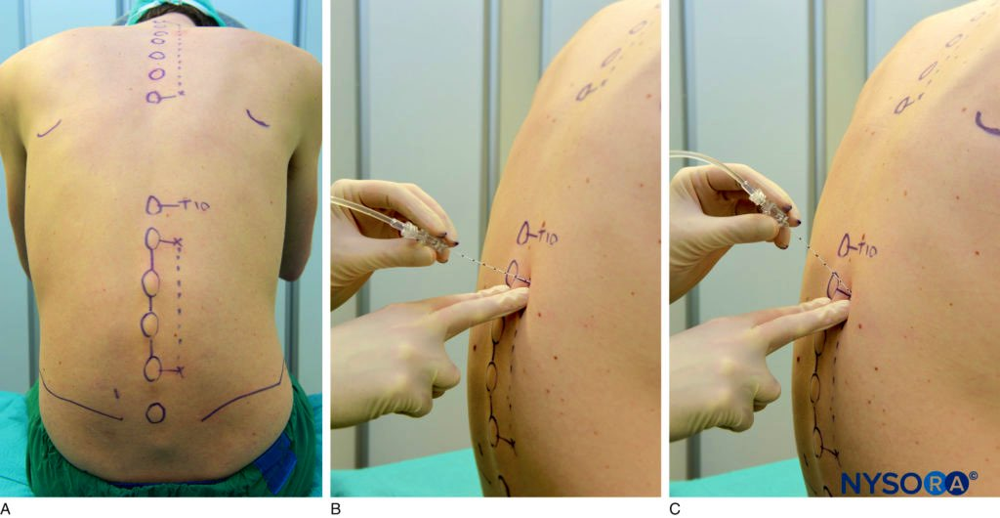
Paravertebral Block
Injecting anesthetic adjacent to the thoracic vertebrae.
Effectiveness:
  Effective for the second stage of labor (case reports)
  Post-C/S delivery analgesia

Slide 23

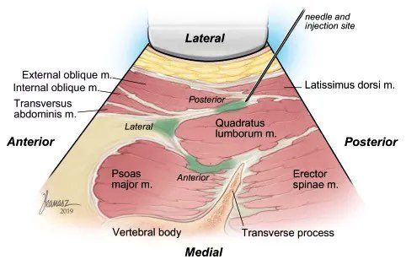
Quadratus Lumborum Block (QLB)
Targets the quadratus lumborum muscle.
Effectiveness:
  Effective for C/S pain relief.
  Also used in postoperative pain management for various surgeries.

Slide 24
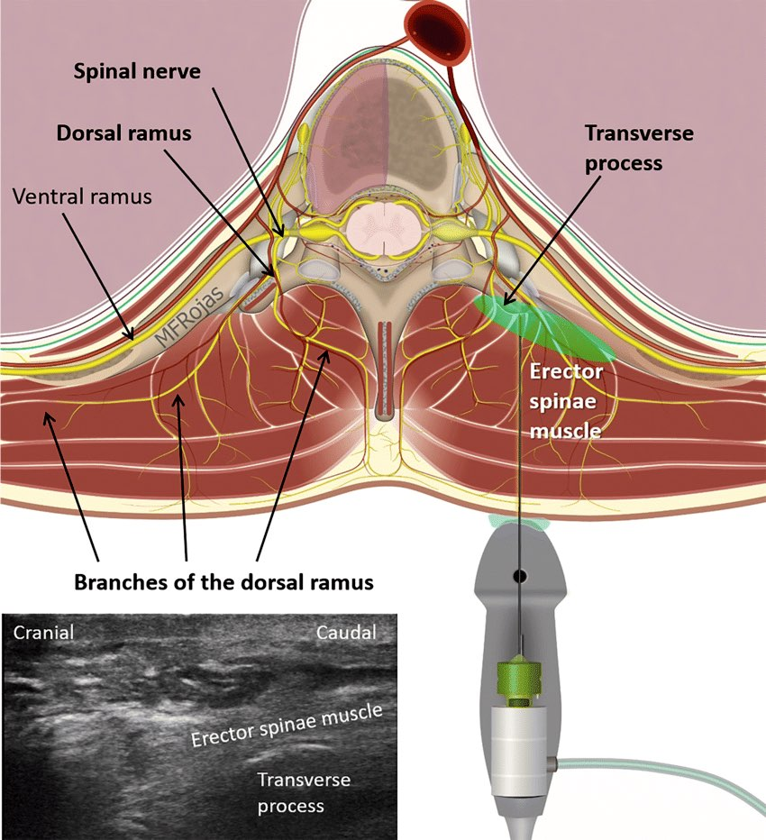
Erector Spinae Plane Block (ESPB)
Injecting anesthetic between the transverse process and the erector spinae muscle.
Effectiveness:
  Effective for labor pain relief (few cases)
  Also used in various surgical settings

Slide 25

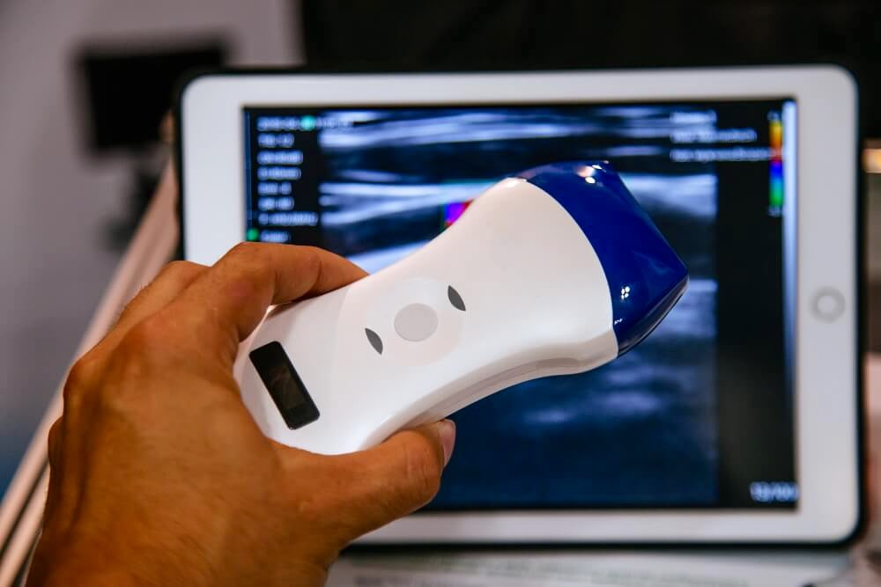
Ultrasound Guidance
Crucial in regional anesthesia
Benefits: improves accuracy and safety
Precise needle placement is essential to avoid complications.

Slide 26
References
J Clin Monit Comput. 2000;16(8):597-608. doi: 10.1023/a:1012268617009. Neonatal monitoring after maternal fentanyl analgesia in labor. E M Nikkola 1, T J Jahnukainen, U U Ekblad, P O Kero, M A Salonen
Reg Anesth Pain Med. 2016 Mar-Apr;41(2):140-5. doi: 10.1097/AAP.0000000000000355. Ultrasound-Guided Pudendal Nerve Block at the Entrance of the Pudendal (Alcock) Canal: Description of Anatomy and Clinical Technique. Thomas Fichtner Bendtsen 1, Teresa Parras, Bernhard Moriggl, Vincent Chan, Lilli Lundby, Steen Buntzen, Karoline Dalgaard, Birgitte Brandsborg, Jens Børglum
Reg Anesth Pain Med. 2016 Sep-Oct;41(5):621-7. doi: 10.1097/AAP.0000000000000451. The Erector Spinae Plane Block: A Novel Analgesic Technique in Thoracic Neuropathic Pain. Mauricio Forero 1, Sanjib D Adhikary, Hector Lopez, Calvin Tsui, Ki Jinn Chin
Anesthesiology. 2002 Aug;97(2):521; author reply 521-2. doi: 10.1097/00000542-200208000-00037. The use of a nerve stimulator for thoracic paravertebral block. Scott A Lang
Front Surg. 2022 Apr 1;9:674987. doi: 10.3389/fsurg.2022.674987. Efficacy of Transversus Abdominis Plane Block in Patients After Laparoscopic Radical Cervical Cancer Surgery. Xiaoyu Ma 1,†, Yi Gao 1,†, Jing Wang 2, Zhen Wu 3, Huasu Shen 1, Ping Wang 1,*
Anaesth Rep. 2020 Nov 12;8(2):e12083. doi: 10.1002/anr3.12083. The erector spinae plane block for obstetric analgesia: a case series of a novel technique. J S Vilchis Rentería 1, P W H Peng 2, M Forero 3,✉
A A Pract. 2020 May;14(7):e01193. doi: 10.1213/XAA.0000000000001193. Posterior Quadratus Lumborum Block for Labor Analgesia: A Case Report. Johanna Blair de Haan 1, Subhan Tabba, Linden O Lee, Semhar Ghebremichael, Sudipta Sen, Daniel Shoham, Nadia Hernandez
ANESTHESIA IN OBSTETRICS. Regional methods of anesthesia in labor pain relief: a systematic review. Published 28.10.2022. O.A. Makcharin+Elena A. Lebedeva+N.V. Kochubeinik+
Br J Anaesth. 2009 Apr;102(4):534-9. doi: 10.1093/bja/aep015. Epub 2009 Feb 24. Ultrasound-guided paravertebral puncture and placement of catheters in human cadavers: an imaging study. C Luyet 1, U Eichenberger, R Greif, A Vogt, Z Szücs Farkas, B Moriggl
Reg Anesth Pain Med . 2016 Nov/Dec;41(6):757-762. doi: 10.1097/AAP.0000000000000495. Quadratus Lumborum Block Versus Transversus Abdominis Plane Block for Postoperative Pain After Cesarean Delivery: A Randomized Controlled Trial. Rafael Blanco 1, Tarek Ansari, Waleed Riad, Nanda Shetty

Slide 27
References
Can Fam Physician. 2007 Mar;53(3):437–442. Single-dose intrathecal analgesia to control labour pain. Is it a useful alternative to epidural analgesia? RG Minty, Len Kelly, Alana Minty, DC Hammett
Anesth Pain Med. 2021 Mar 1;11(1):e108335. doi: 10.5812/aapm.108335. Comparison of Spinal Versus Epidural Analgesia for Vaginal Delivery: A Randomized Double Blinded Clinical Trial. Farnad Imani, Sarah Lotfi, Javad Aminisaman, Afshar Shahmohamadi, Abbas Ahmadi
OBSTETRIC ANESTHESIOLOGY: RESEARCH REPORT. Continuous Spinal Analgesia for Labor and Delivery, An Observational Study with a 23-Gauge Spinal Catheter. Tao, Weike MD*; Grant, Erica N. MD, MSc*; Craig, Margaret G. MD*; McIntire, Donald D. PhD†; Leveno, Kenneth J. MD
Continuous Spinal Analgesia for Labor and Delivery. Tao, Weike MD*; Grant, Erica N. MD, MSc*; Craig, Margaret G. MD*; McIntire, Donald D. PhD†; Leveno, Kenneth J. MD†. Anesthesia & Analgesia 121(5):p 1290-1294, November 2015. | DOI: 10.1213/ANE.0000000000000903
Single-dose intrathecal analgesia: a safe and effective method of labor analgesia for parturients in low resource areas. Gian Chauhan, Poonam Samyal & Anshit Abhi Pathania. Ain-Shams Journal of Anesthesiology. volume 12, Article number: 23 (2020)
BJA REVIEW ARTICLE. Volume 20, Issue 3P96-102March 2020. Open Archive. Neuraxial analgesia for labour. B. Shatil1 ∙ R. Smiley2 rms7@cumc.columbia.edu
American Journal of Obstetrics & gynecology volume 228, Issue 5, Supplement S1260-S1269May 2023. Modern labor epidural analgesia: implications for labor outcomes and maternal-fetal health

