Slide 1
Pulmonary Aspiration
2023
OpenAnesthesia®️

Slide 2
Key Points
Initial Effects:
Chemical pneumonitis
Irritation of the lung parenchyma within the first 1-2 hours
Subsequent acute inflammation
Progression:
Majority of aspiration events do not develop into bacterial pneumonia
Chronic Effects:
Lung abscess formation typically occurs in patients with chronic aspiration

Slide 3
Introduction
Definition:
Pulmonary aspiration: Inhalation of substances from the oral cavity or upper gastrointestinal tract
Range of aspirated materials: Saliva, toxins, gastric contents
Aspiration Pneumonia:
Umbrella term for adverse pulmonary consequences from aspiration
Includes chemical pneumonitis and bacterial aspiration pneumonia
Chemical Pneumonitis:
Aspiration of substances causing inflammatory reactions in the lower airways
Inflammation occurs independent of bacterial infection

Slide 4
Introduction
Bacterial Aspiration Pneumonia:
Active infection resulting from inoculation of bacteria into the lungs via orogastric contents
Incidence and Outcomes:
Aspiration is common; estimated that as many as half of all adults aspirate during sleep
Outcomes vary from normal physiological responses to severe infectious complications

Slide 5
Introduction
Historical Context:
Chemical pneumonitis from aspiration first described by Curtis Lester Mendelson (Mendelson syndrome)
Observed in young and healthy obstetrical patients following aspiration of gastric acid under anesthesia

Slide 6
Introduction
Conditions that predispose to aspiration include:
Altered consciousness: seizures, alcoholism, head trauma, general anesthesia, drug overdose, etc.
Neurological disorders: stroke, multiple sclerosis, Parkinson’s disease, myasthenia gravis
Advanced age
Cardiac arrest
Dysphagia: esophageal stricture, neoplasm, diverticula, achalasia, tracheoesophageal fistula, xerostomia, etc.
Mechanical disruption of usual defenses: nasogastric (NG) tube, endotracheal intubation, tracheostomy, bronchoscopy, etc.
Periodontal disease
Others: gastric outlet obstruction, large volume NG tube feeds, recumbent position, gastroparesis, etc.

Slide 7
Clinical Presentation and Diagnosis
Patients commonly present with:
Tachypnea
Tachycardia
Decreased breath sounds
Rales or diffuse crackles
Fever or hypothermia
Hypoxia/hypoxemia
Cough with purulent sputum production

Slide 8
Clinical Presentation and Diagnosis
Radiological Findings in Pulmonary Aspiration:
Infiltrates:
Often observed in the dependent lung segments
Not exclusively limited to dependent segments (Figures 1 and 2)
Aspiration-Related Lung Abscesses:
Presence of cavitary lesions

Slide 9
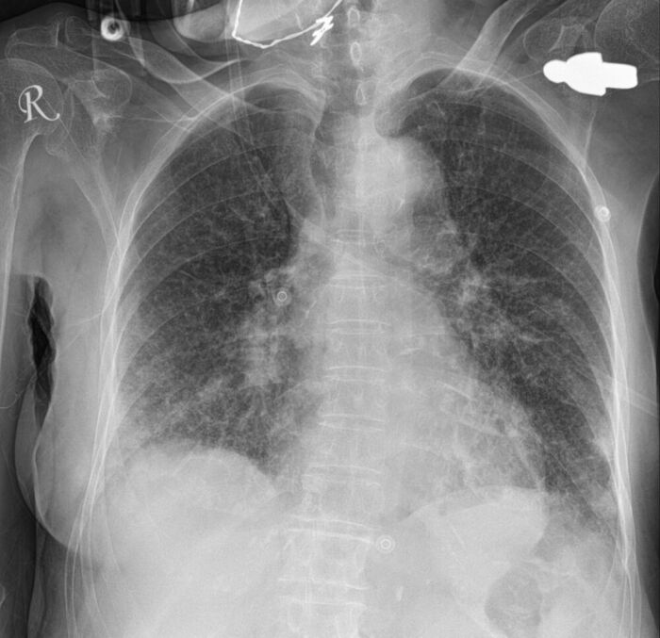
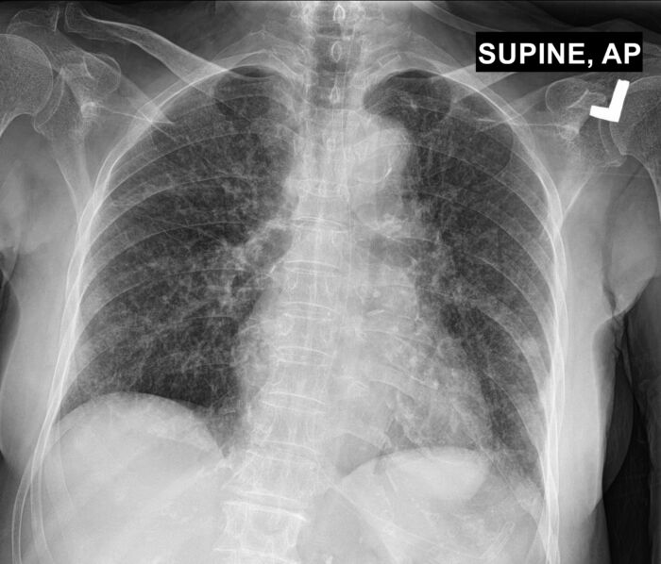
Figure 1. Initial chest radiography (CXR) of a patient with suspected aspiration showing bilateral patchy infiltrates, mainly in the lower lobes.
Figure 2. Chest radiography (CXR) 3 days later showing improvement in the right lung. The left lung still has patchy infiltrates.

Slide 10
Pathogens
Common Pathogens:
Respiratory flora such as Streptococcus pneumoniae (S. pneumoniae)
Haemophilus influenzae (H. influenzae)
Additional Considerations for Specific Patient Populations:
Hospitalized patients
Patients from nursing homes
Enteric gram-negative bacteria, in addition to respiratory flora

Slide 11
Management
Immediate treatment
Oropharyngeal Suctioning:
Perform immediately to remove aspirated material
Patient Positioning:
Place the patient in the Trendelenburg position
Turn the patient's head to the side to prevent further aspiration
Intubation and Suctioning:
Intubate the patient
Suction the endotracheal tube
Bronchoalveolar Lavage:
Consider using bronchoalveolar lavage to clear particulate matter

Slide 12
Management
Treatment of Aspiration Pneumonitis
Supportive Care:
Symptoms usually resolve in 24-48 hours with supportive care
Supplemental oxygen or noninvasive positive pressure ventilation
Severe Cases:
Intubation
Invasive positive pressure ventilation may be required
Antibiotics: Typically not indicated for most aspiration events, despite radiographic findings
Consider antibiotics if:
The patient is hemodynamically unstable
Symptoms persist for more than 48 hours
There is another potential source of infection
Glucocorticoids: Routine use is not recommended for aspiration pneumonitis.

Slide 13
Management
Treatment of Aspiration Pneumonia
The Infectious Disease Society of America (IDSA) guidelines do not recommend adding anaerobic coverage for suspected aspiration beyond standard empiric treatment for community-acquired pneumonia.
Aspiration event occurred in community or within 72 hours of hospital admission | Aspiration event occurred more than 72 hours after hospital admission or severe illness (0.0.. Intensive Care Unit level of care)
- Treat as community-acquired pneumonia (CAP) without atypical coverage - (link to pneumonia summon,) | - Treat as hospitalacquired pneumonia (HAP) - Pink to pneumonia summary)

Slide 14
Special Considerations
Postobstructive pneumonia can develop distal to a bronchial obstruction (e.g., malignancy).
This is often due to the accumulation of secretions rather than an acute infection.
It should be treated as CAP or HAP depending on the severity of illness.
Lung abscess/empyema
Usually occurs in chronic aspiration and is often subacute
Usually associated with periodontal disease and/or alcoholism
Possible treatment regimens are listed in Table 2.

Slide 15
Mild to moderate illness | Severe illness
- Ampicillirdsulbactam - Ceftriaxone PLUS clindarnycin or metronidezole | - Piperacillinhazobactam - Cefepime PLUS rnetronidazole - Severe penicillin allergy: moxilloxnein

