Slide 1
PBLS
Dariush Abtahi, MD
Assistant Professor of Anesthesiology, Clinical Research and Development Unit Imam Hossein Hospital, Anesthesiology Department, Shahid Beheshti University of Medical Sciences, Tehran, Iran
drdariushabtahi@yahoo.com

Slide 2
Sequences of Resuscitation

Slide 3
Improve outcomes:
rapid recognition
immediate chest compressions
effective ventilations
Lay rescuers should not delay starting CPR in a child with no “signs of life.”

Slide 4
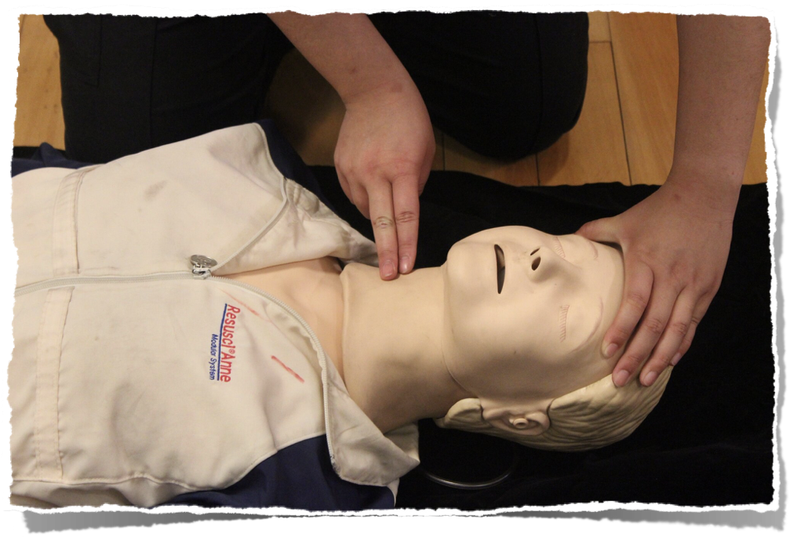
Healthcare providers: assessing the pulse: 10 seconds
Palpation for the presence or absence of a pulse is not reliable as the sole determinant of cardiac arrest and the need for chest compressions.

Slide 5
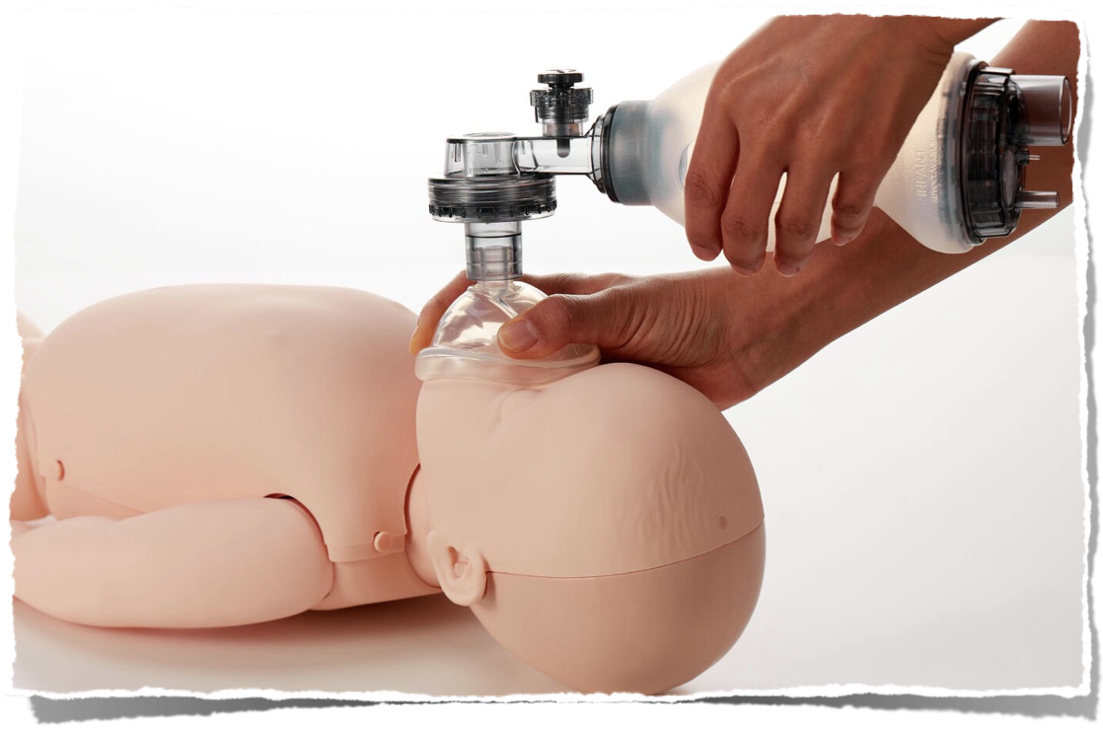
Infants and children: asphyxial cardiac arrest is more common than cardiac arrest from a primary cardiac event:
effective ventilation is important

Slide 6
5 main components of high-quality CPR:
adequate chest compression depth
optimal chest compression rate
minimizing interruptions in CPR (maximizing chest compression fraction)
full chest recoil between compressions
avoiding excessive ventilation

Slide 7
Initiation of CPR

Slide 8
Lay rescuers are unable to reliably determine the presence/absence of a pulse.
High error rate and harmful CPR pauses during manual pulse checks by trained rescuers.
Only a small delay (5.74 seconds) in commencement of rescue breathing with CAB compared with ABC

Slide 9
Components of High Quality CPR

Slide 10
Best outcomes with compression-ventilation CPR- outcomes for infants with OHCA are often poor
Compression-only CPR is superior to no bystander CPR
Complete chest re-expansion improves the flow of blood returning to the heart

Slide 12
Increased systolic blood pressures with chest compression rates 100 - 120/min (compared with rates exceeding 120/min)
Pediatric chest can be compressed to one-third of the anterior-posterior chest diameter.
Brief rhythm check every 2 minutes when a monitor or AED is available
No human studies addressing the effect of varying inhaled oxygen concentrations during CPR on outcomes in infants and children.

Slide 13
The optimum compression-to-ventilation ratio is uncertain:
single rescuers: 30:2
2 rescuers: 15:2
The optimum ventilation rate during continuous chest compressions in children with an advanced airway requires further study.
1 breath every 2–3 s (20–30 breaths/min)

Slide 14
CPR Technique

Slide 15
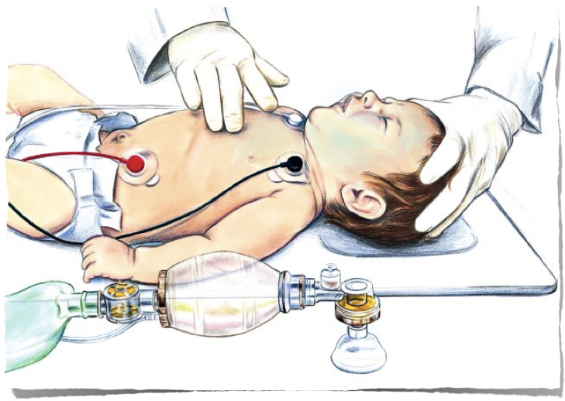
For infants, optimal cardiac compressions: fingers placed just below the intermammary line

Slide 16
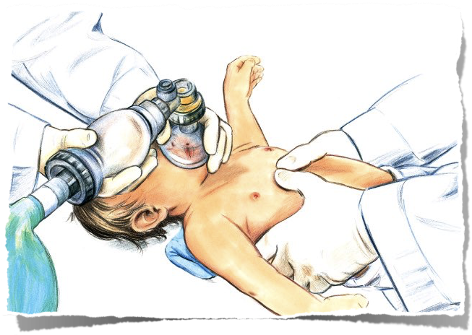
2-thumb– encircling hands technique:
improve CPR quality- depth
2 rescuers
lower chest compression fractions
incomplete chest recoil

Slide 17
For children: 1-hand or 2-hand technique?
2-hand technique:
improve compression depth
improve compression force
less rescuer fatigue

Slide 18
Support Surfaces for CPR

Slide 19
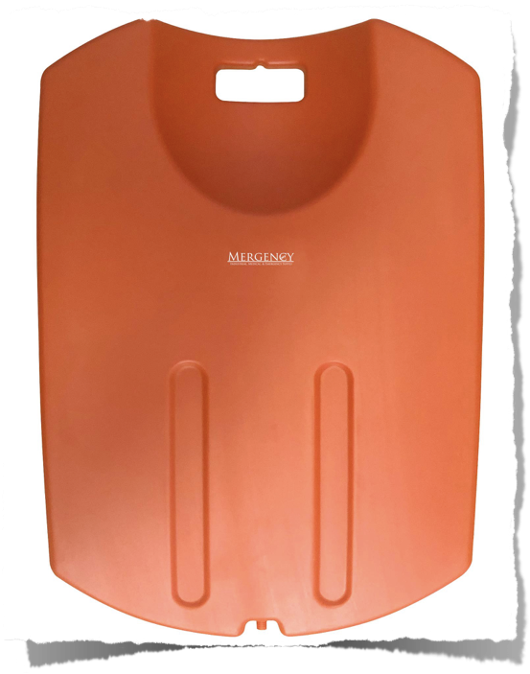
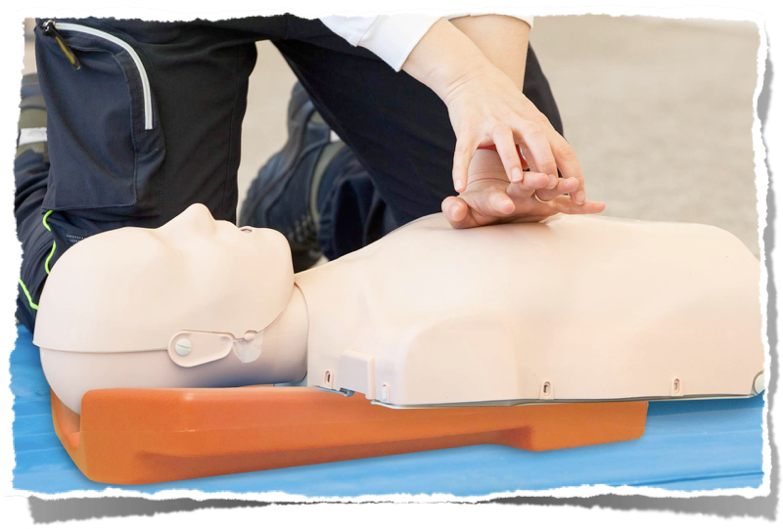
“CPR mode”: available on some hospital beds
Reduce sternal displacement
Reduce effective chest compression depth

Slide 20
Opening the Airway

Slide 21
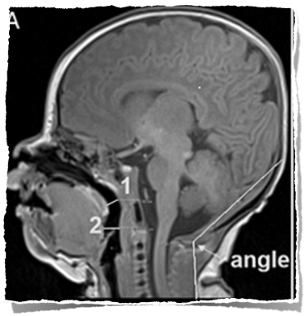
No data directly address the ideal method to open or maintain airway patency.
The proposed highest proportion of patent airways with the head-tilt angle of 144 to 150 degrees

Slide 22
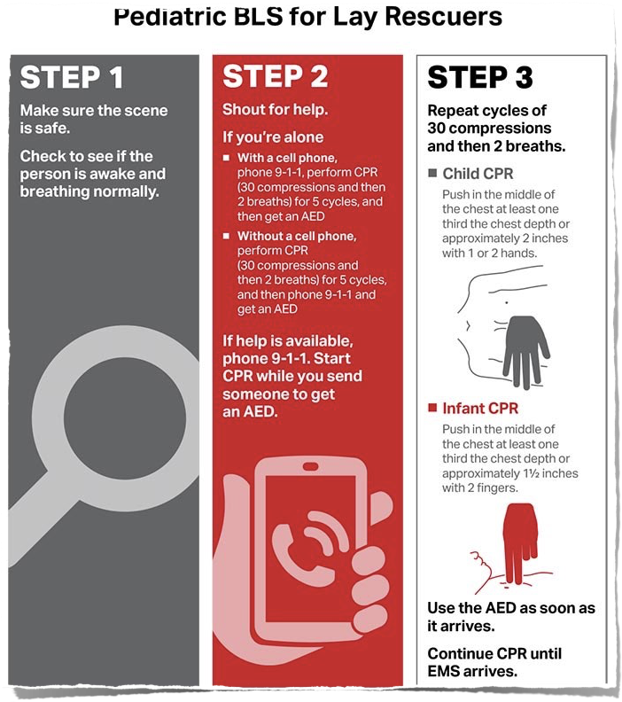

Slide 23
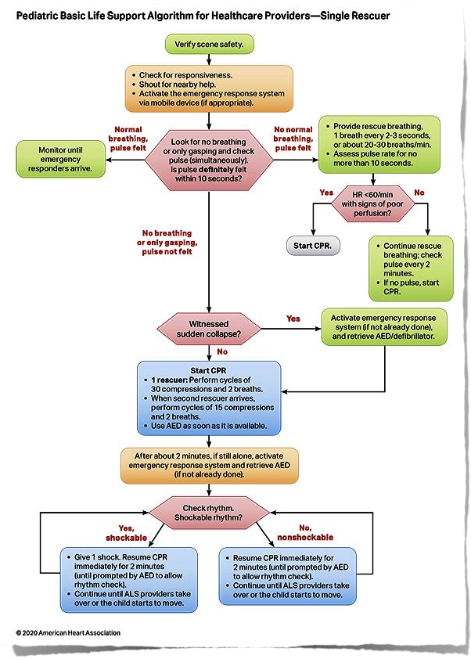

Slide 24
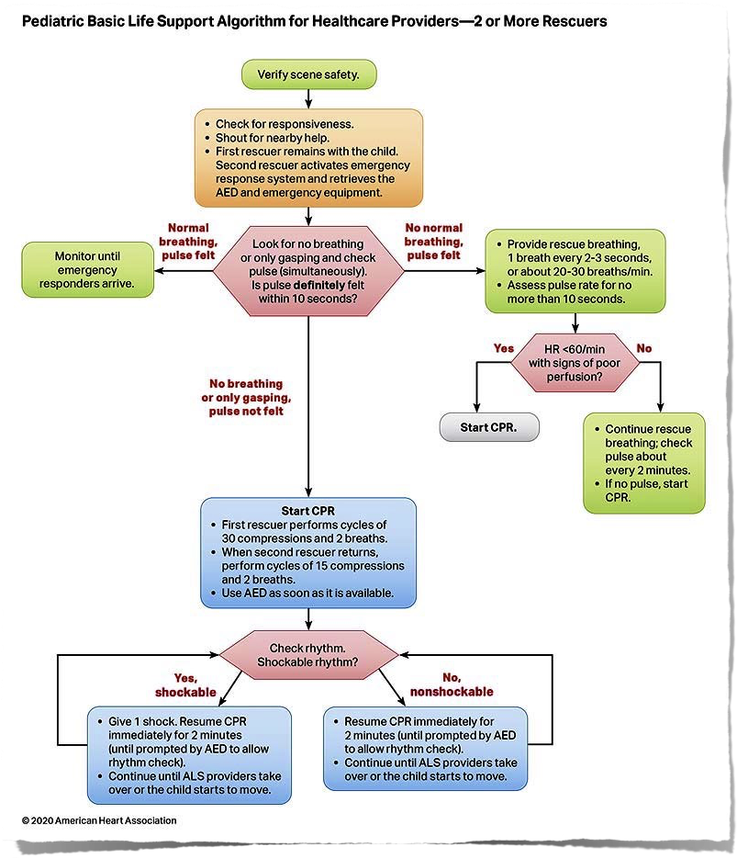

Slide 25
